Slide 1

Year Six SATs Information

Slide 2
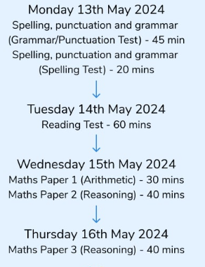

KS2 SATS Week 2024
It is vital that your child is in school for every test.

Slide 3
How do the tests take place?
The tests all take place in normal school time and are under test conditions.
The completed papers are sent away to be marked externally.
Results are returned to school in July.
The tests vary in length but last no longer than 60 minutes:
- Reading: 60 minutes
- Grammar, Punctuation & Vocabulary: 45 minutes
- Spelling: 15 minutes
- Arithmetic: 30 minutes
- Mathematical Reasoning: 2 papers of 40 minutes each.
If your child is ill the school can apply for permission to complete a timetable variation for them to complete it another day – early communication with school is vital.

Slide 4
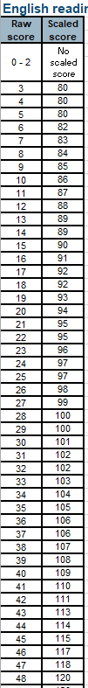
What results will my child receive?
Each pupil registered for the tests will receive:
•a raw score (number of raw marks awarded)
•a scaled score, for the KS2 tests a scaled score of 100 will always represent the ‘expected standard’
•confirmation of whether or not they attained the national standard or possibly are greater depth (GD) in the subject.

Slide 5

How does the scaled score work?
120
The Government have decided the scale will centre at 100 points.
This 100 points represents a child who has met the expected standard for Year 6
Centring around 100, the scale will run from 80 to 120.
Maximum score
100
Y6 standard
80
Minimum score
In 2023, to be at the expected level for end of Year 6
Raw Reading = 24 marks out of 50 (38 for higher)
Raw maths = 56 marks out of 110 (across 3 papers) (94 for higher)
Raw SPAG = 36 marks out of 70 (across spelling and grammar papers) (55 for higher)

Slide 6
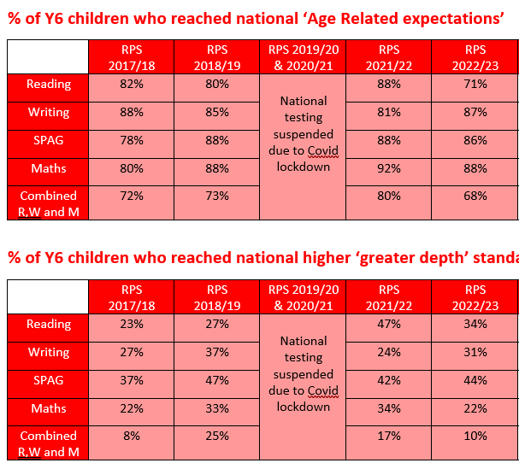

Slide 7

How can you support your child at home?

Slide 8
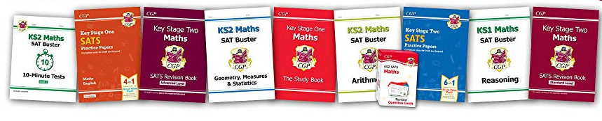
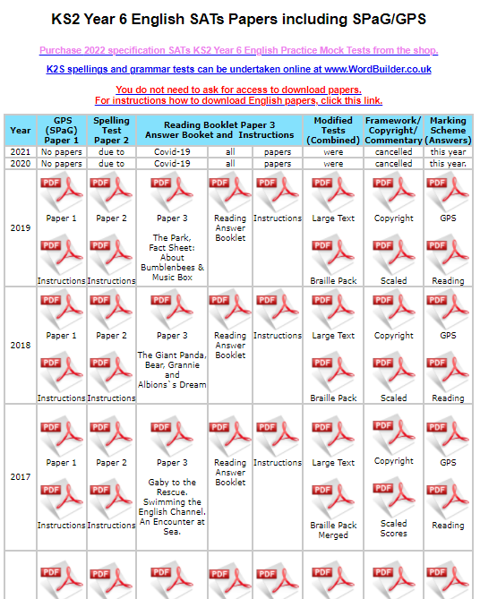
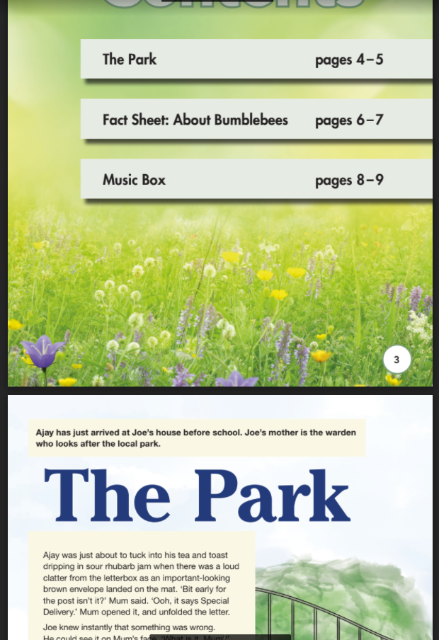
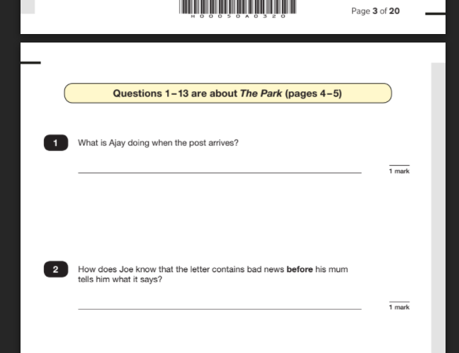
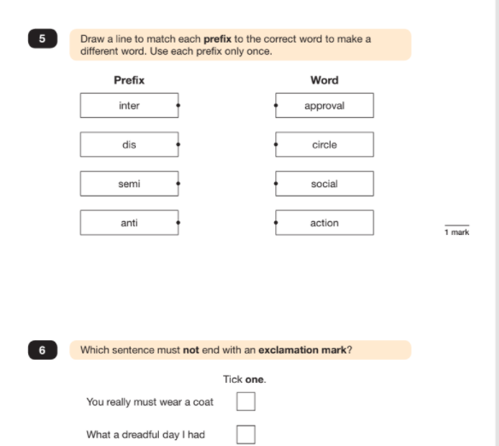
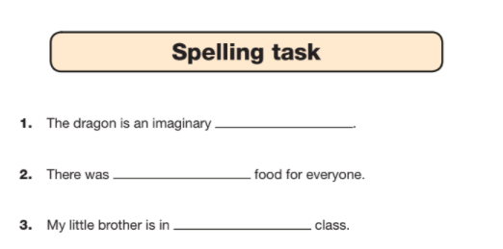
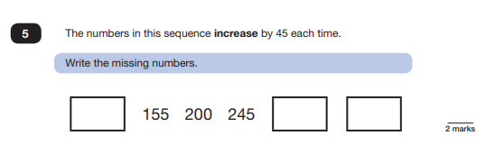
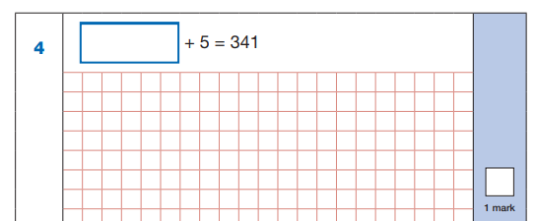
Revision
Little but often
Make it fun!
Use revision books
Websites
Pretend you don’t know
www.satspapers.org.uk
Past GPS, Spelling and Maths arithmetic and reasoning tests:
Reading papers – 3 sections – 20mins to read and answer
Little but often
Fun!
Pretend you don’t know

Slide 9
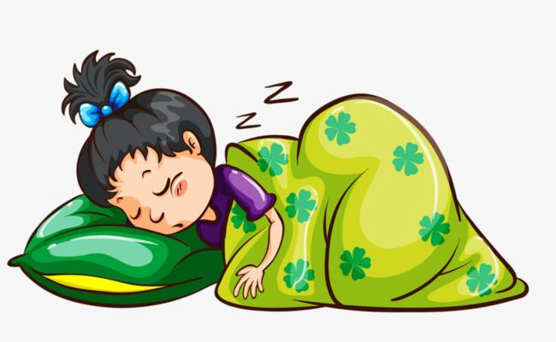
Approaching SATs, we recommend:
Early nights and lots of sleep
Reduce mobile phone time and monitor social media posts/communications
Water bottle in school and children can bring a fruit snack for playtime
• Good attendance (they may miss their last reminders about a topic)
• Good punctuality
• A good breakfast every day
• A positive attitude - encourage your child to embrace the mistakes that they make and to learn from them
Encourage them to complete homework to the best of their ability and ask questions
• Lots of praise and encouragement
A sensible approach – we all want your child to do their best but these aren’t GCSEs or A-levels – they are just a check of how things are going….plenty of work still to go after Y6!

Slide 10

What are we doing?
SATs questions based homework – please support them but don’t answer for them!
We will be inviting all Year Six children into school during SATs week for breakfast from 8:30am.
Intervention sessions in school which will alter regularly depending on need
All children will need a water bottle in school so they can have regular drinks.

Slide 11

How can I support my child at home?
Reading
Encourage children to read a range of quality materials frequently
Please feel free to include books, magazines and newspapers you have at home but record this in home school logs. If they want to highlight magazines etc. they should highlight names/dates, vocabulary and figurative language
Look at some of the older classical children’s literature, e.g. Alice in Wonderland, Black Beauty, Treasure Island, Secret Garden and Wind in the Willows, try watching the film/TV versions
Ask your child questions about their reading
My answer is…. What could have been my question?
Read some poems and discuss them
Use revision guides if you have them
Encourage children to work with pace

Slide 12
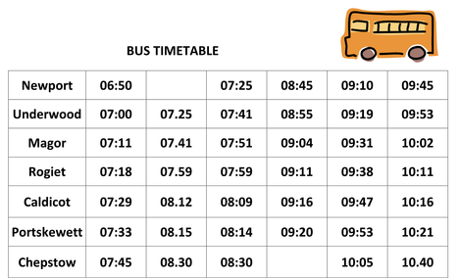
How can I support my child at home?
Maths
Know times tables and division facts fluently
Look at maths vocab, especially for shape
Work on standard written calculation methods
Think about word problems
Use revision guides if you have them
Work on rapid recall of number facts and number bonds – what makes 20, 50, 100 etc?
What can I buy with £18? What change will I have?
Read timetables
Ask them time questions.
Roman Numerals
How many days hath…

Slide 13
How can I support my child at home?
SPAG
Work on the spelling rules with the revision guide
Look at the weekly spelling words in RWI Spelling Log Books
Revision guides if you have them
Revise key terminology
Youtube – anchor education and BBC supermovers
Correct their poor grammar!

