Slide 1

Welcome to Nursery

Slide 2

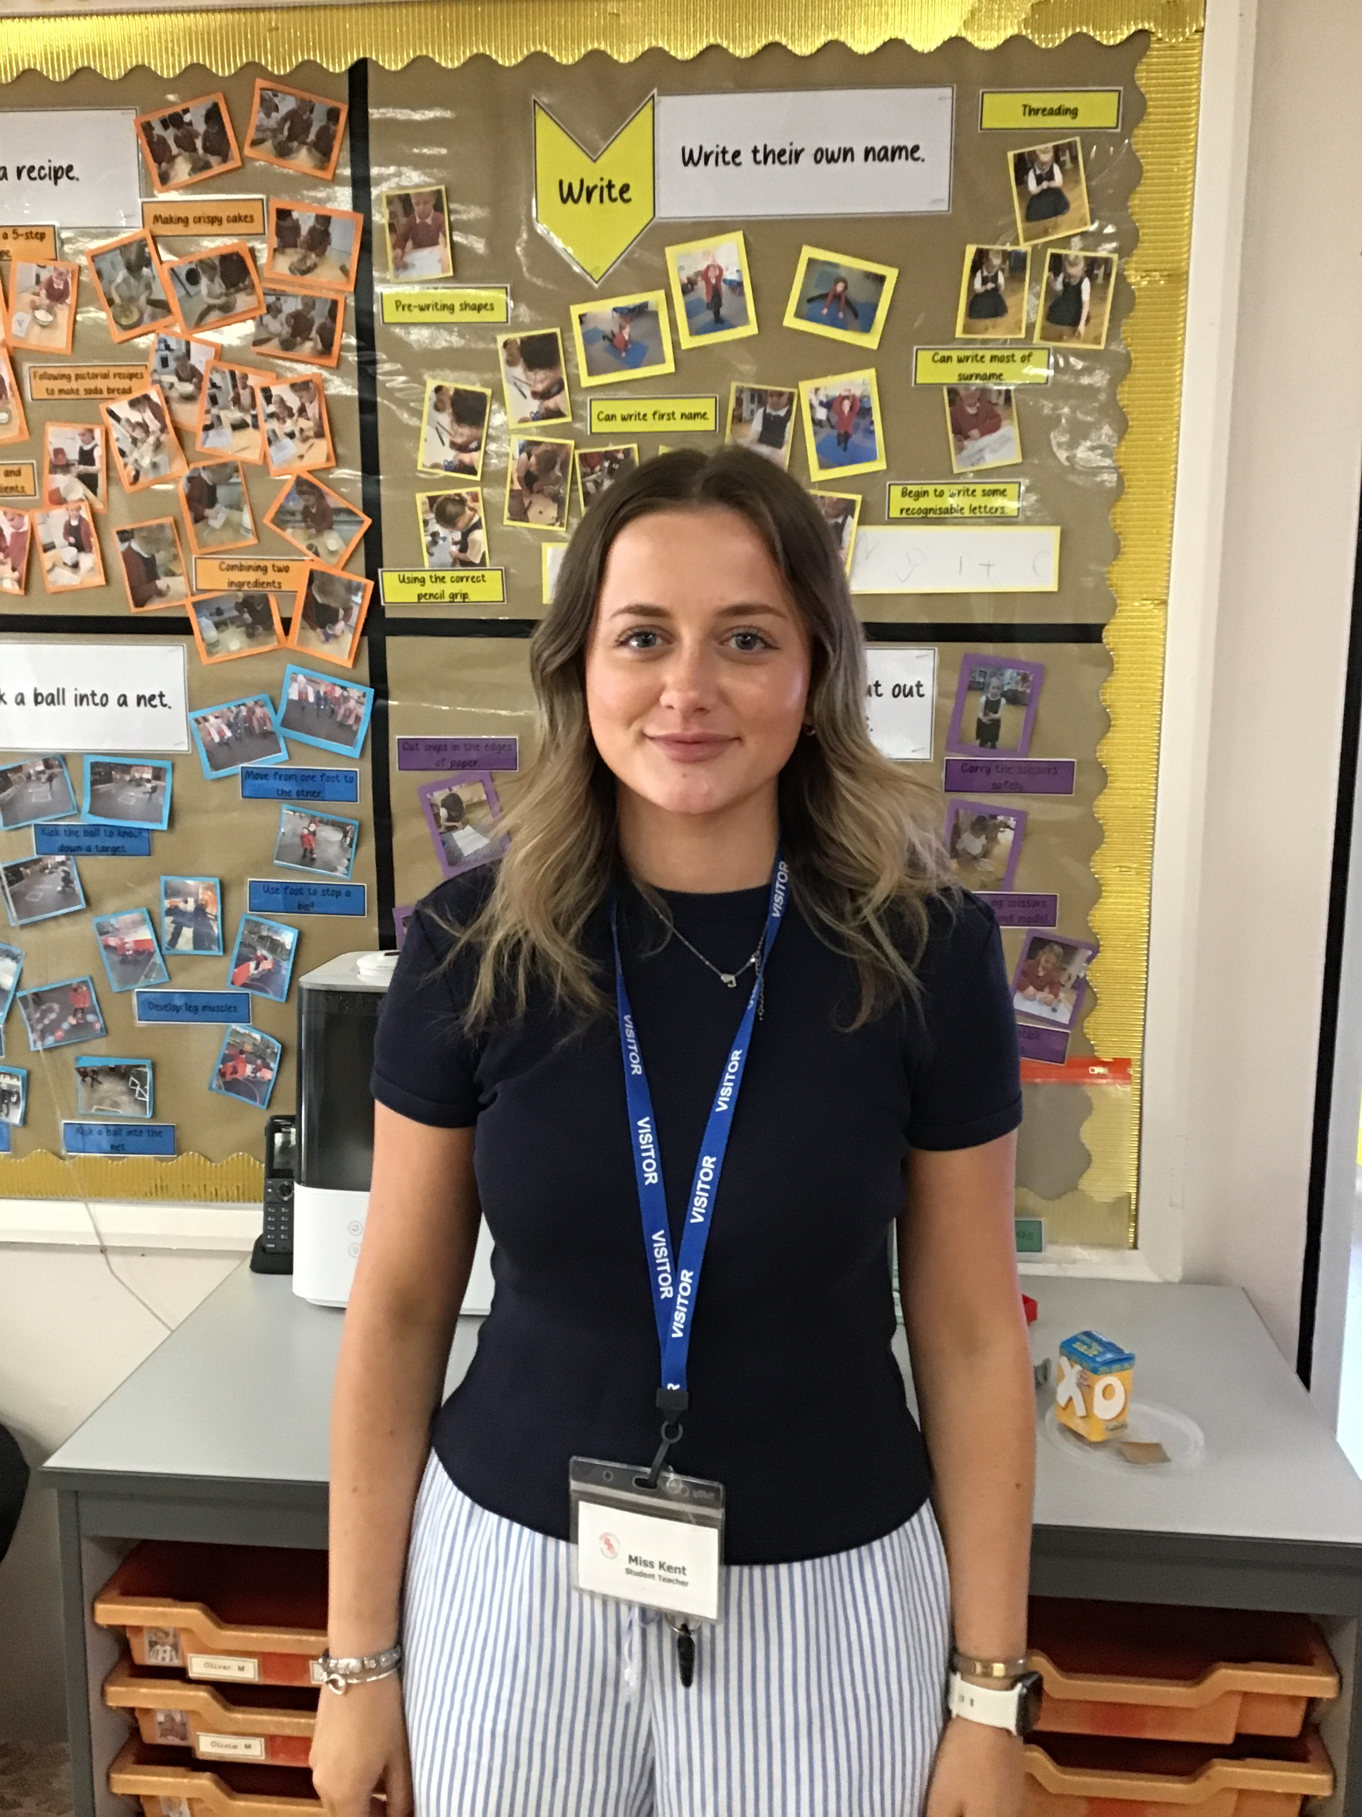
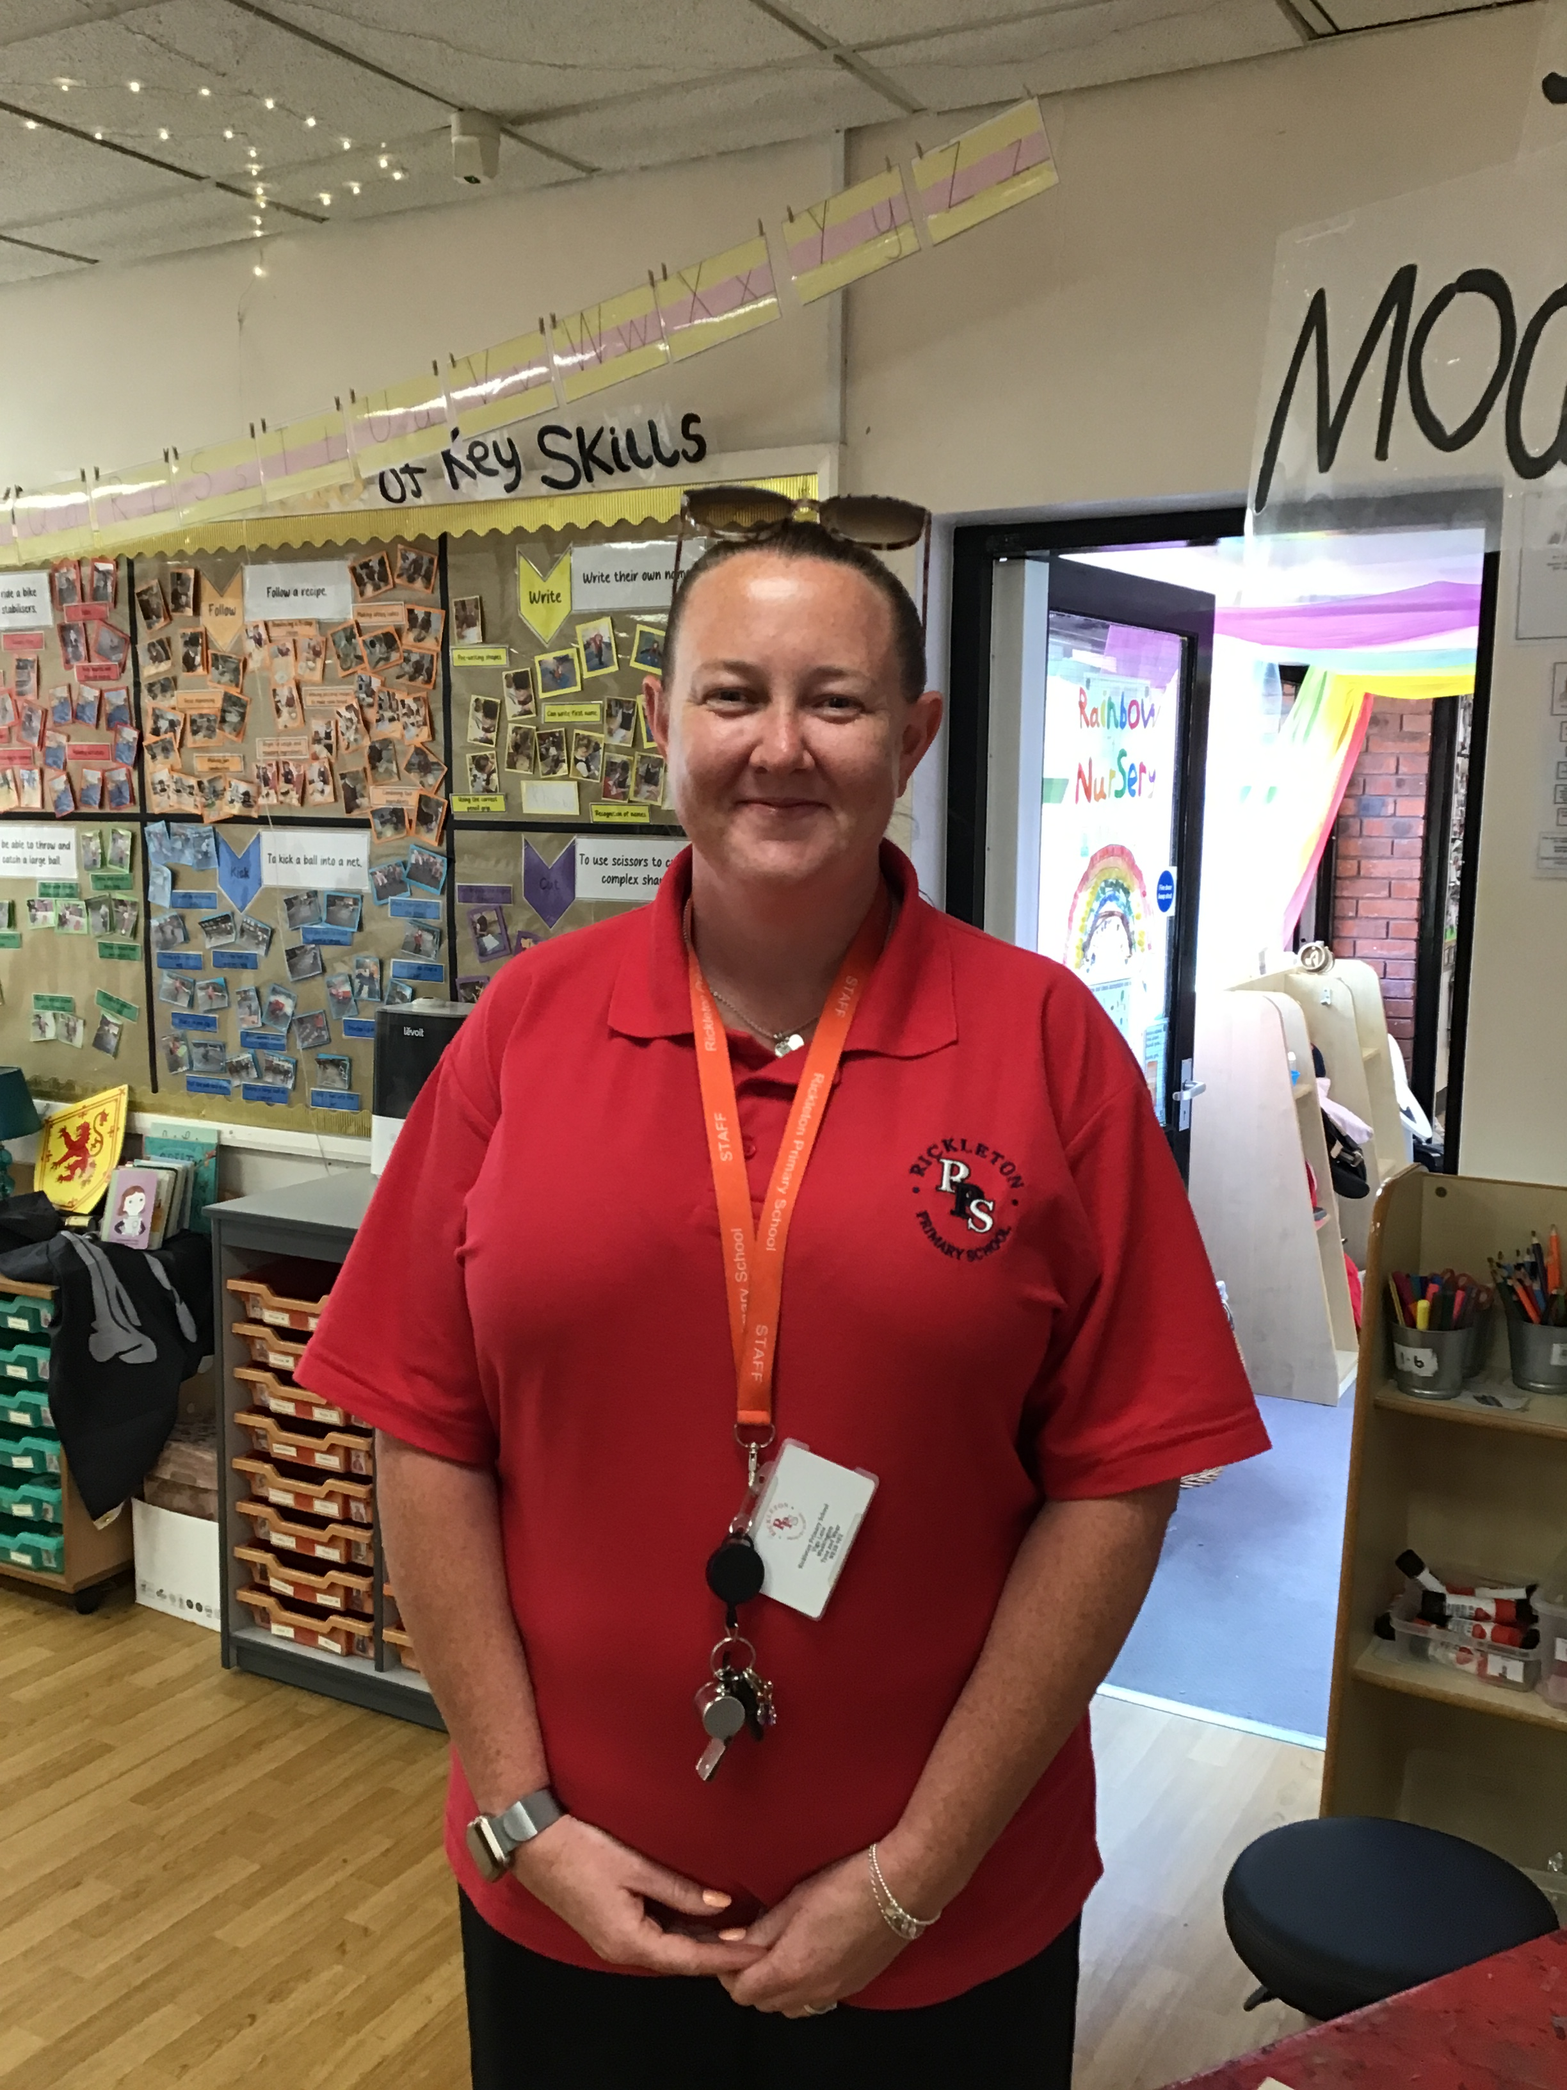
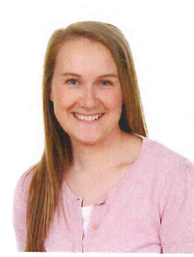
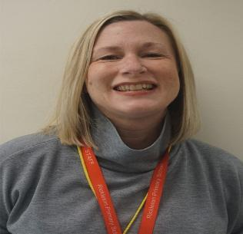
Our Staff
Miss Kent
Miss Bell
Miss Ebdon
Mrs Gregory

Slide 3
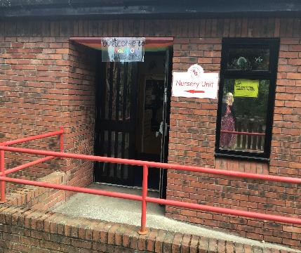
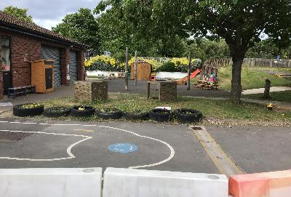
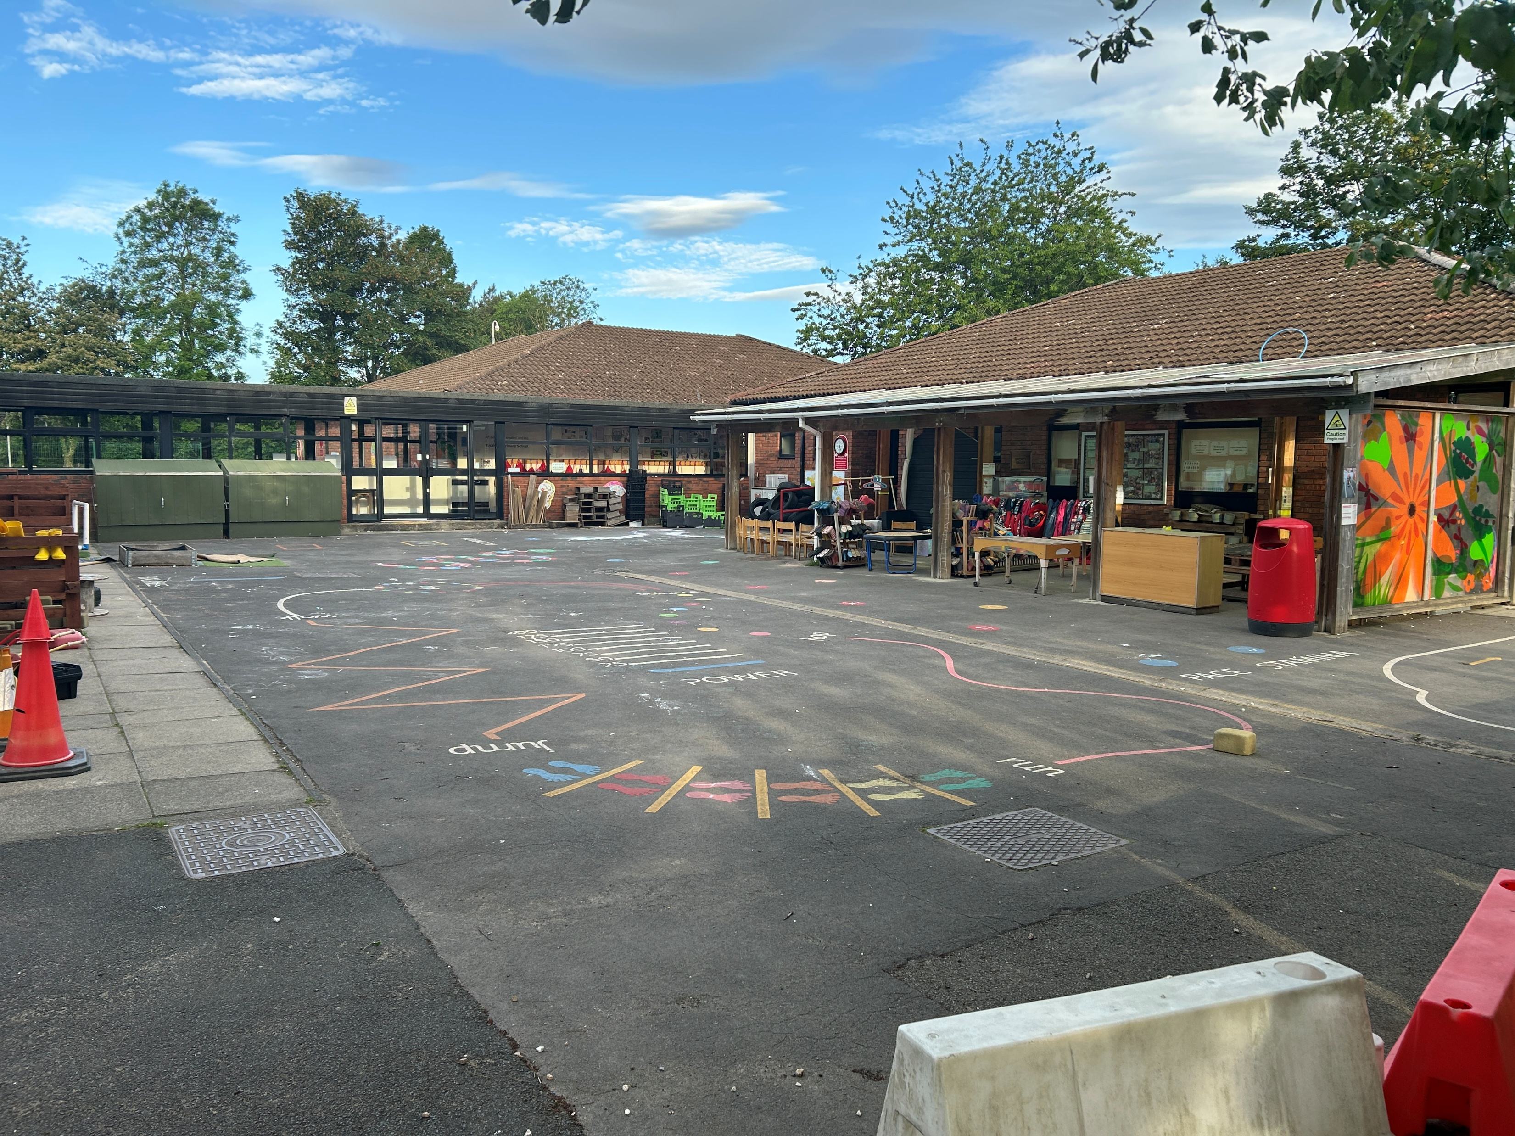
The School Day
Children will enter school via the Nursery entrance and through the Nursery gate.
The doors will open at 8.45am and close at 8.55am for a morning session.
The doors will open at 12.30pm for an afternoon session.
Morning pick up is 11.45am and afternoon pick up is 3.30pm.

Slide 4





PE, Homework and Daily Equipment
PE
PE takes places every Thursday, please send your child’s PE bag in to school. It will stay in school until the end of half term.
Forest School
Forest school will usually take place on a Monday afternoon. We will communicate with you the day before as to whether it will be going ahead. You will need to send your child’s wellies and waterproofs in a named carried bag. These will stay in school and be sent home at the end of each term to be washed and returned.. The children will have access to school’s waterproof and welly store.
Library Books
Our library day is a Tuesday. Please ensure your child has this in school each Tuesday so they can choose a new book.
Letters
Please check your child’s bag regularly for letters sent home. Return slips should be handed directly to the member of staff on the gate, as bags are not checked daily.
Homework
We will send homework books on a Friday. Please return them each week by Tuesday so they can be marked. Dojos are awarded for complete homework.

Slide 5
We look forward to seeing you in September!

