Slide 1

Welcome to Reception

Slide 2

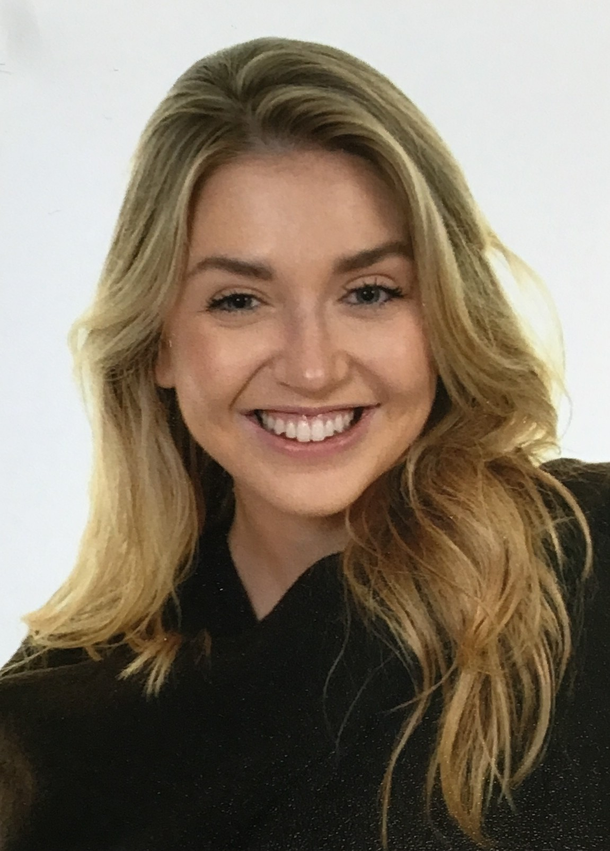
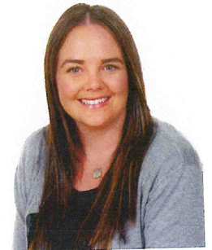
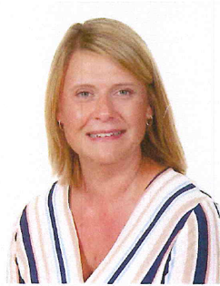
Our Staff
Miss Forsyth
Mrs Meredith
Miss Johnson

Slide 3
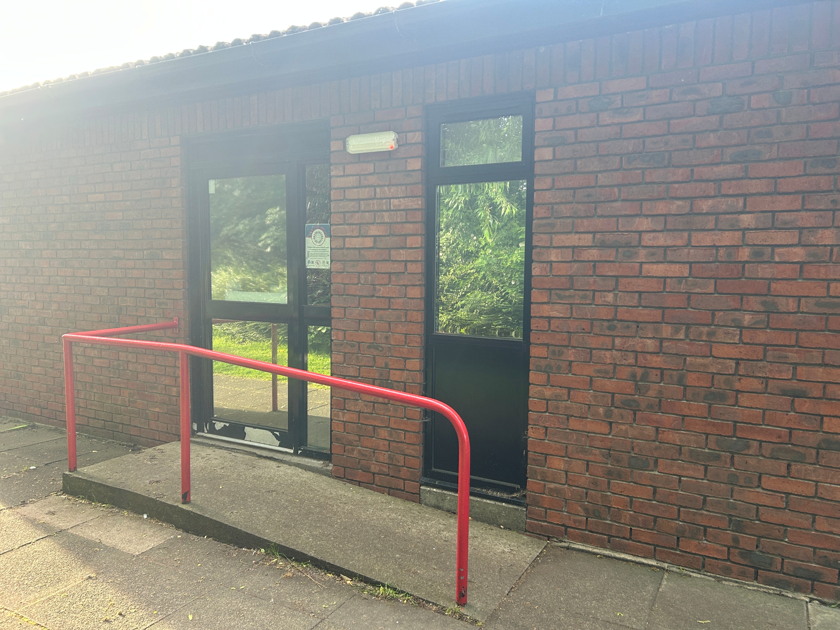
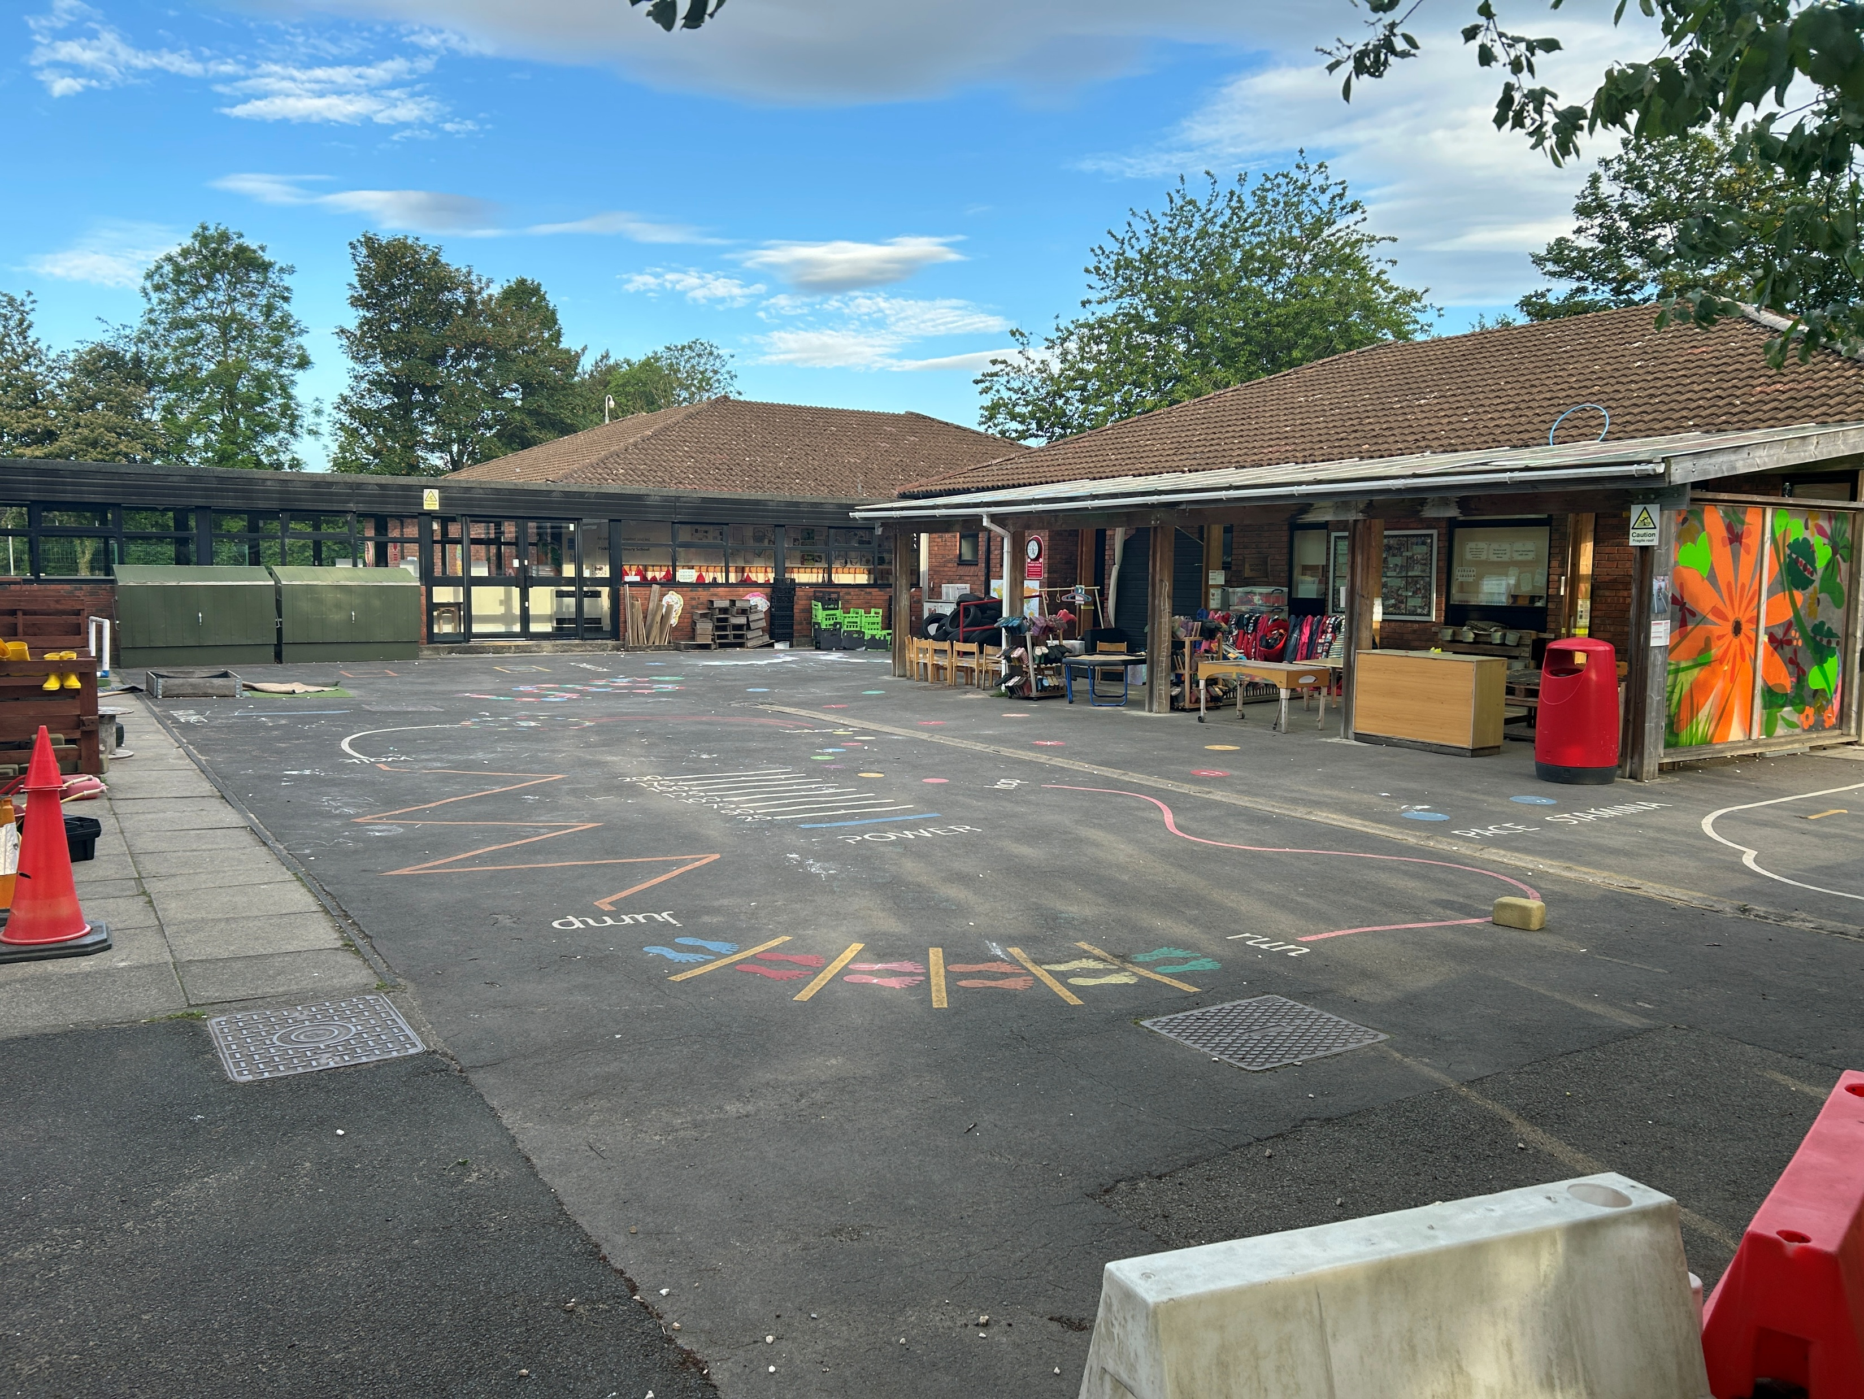
The School Day
Children will enter school via the Reception entrance, located to the right of the Nursery.
The doors will open at 8.45am and close at 8.55am.
Pick up is 3.15pm from the same doors.

Slide 4






PE, Homework and Daily Equipment
Water Bottles
Please ensure your child brings their school water bottle to school empty, every day.
PE
PE takes places every Tuesday, please send your child’s PE bag in to school. It will stay in school until the end of half term.
Library Books
Our library day is a Tuesday. Please ensure your child has this in school each Tuesday so they can choose a new book.
Forest School
Forest school will usually take place on a Monday afternoon. We will communicate with you the day before as to whether it will be going ahead. You will need to send your child’s wellies and waterproofs in a named carried bag. These will stay in school and be sent home at the end of each term to be washed and returned.. The children will have access to school’s waterproof and welly store.
Reading Record
Please make sure your child has their reading record, book and folder in school every day. Dojos are awarded for home reading.
Homework
We will send homework books on a Friday. Please return them each week by Tuesday so they can be marked. Dojos are awarded for complete homework.

Slide 5
We look forward to seeing you in September!

