Slide 1

Welcome to Year Five

Slide 2

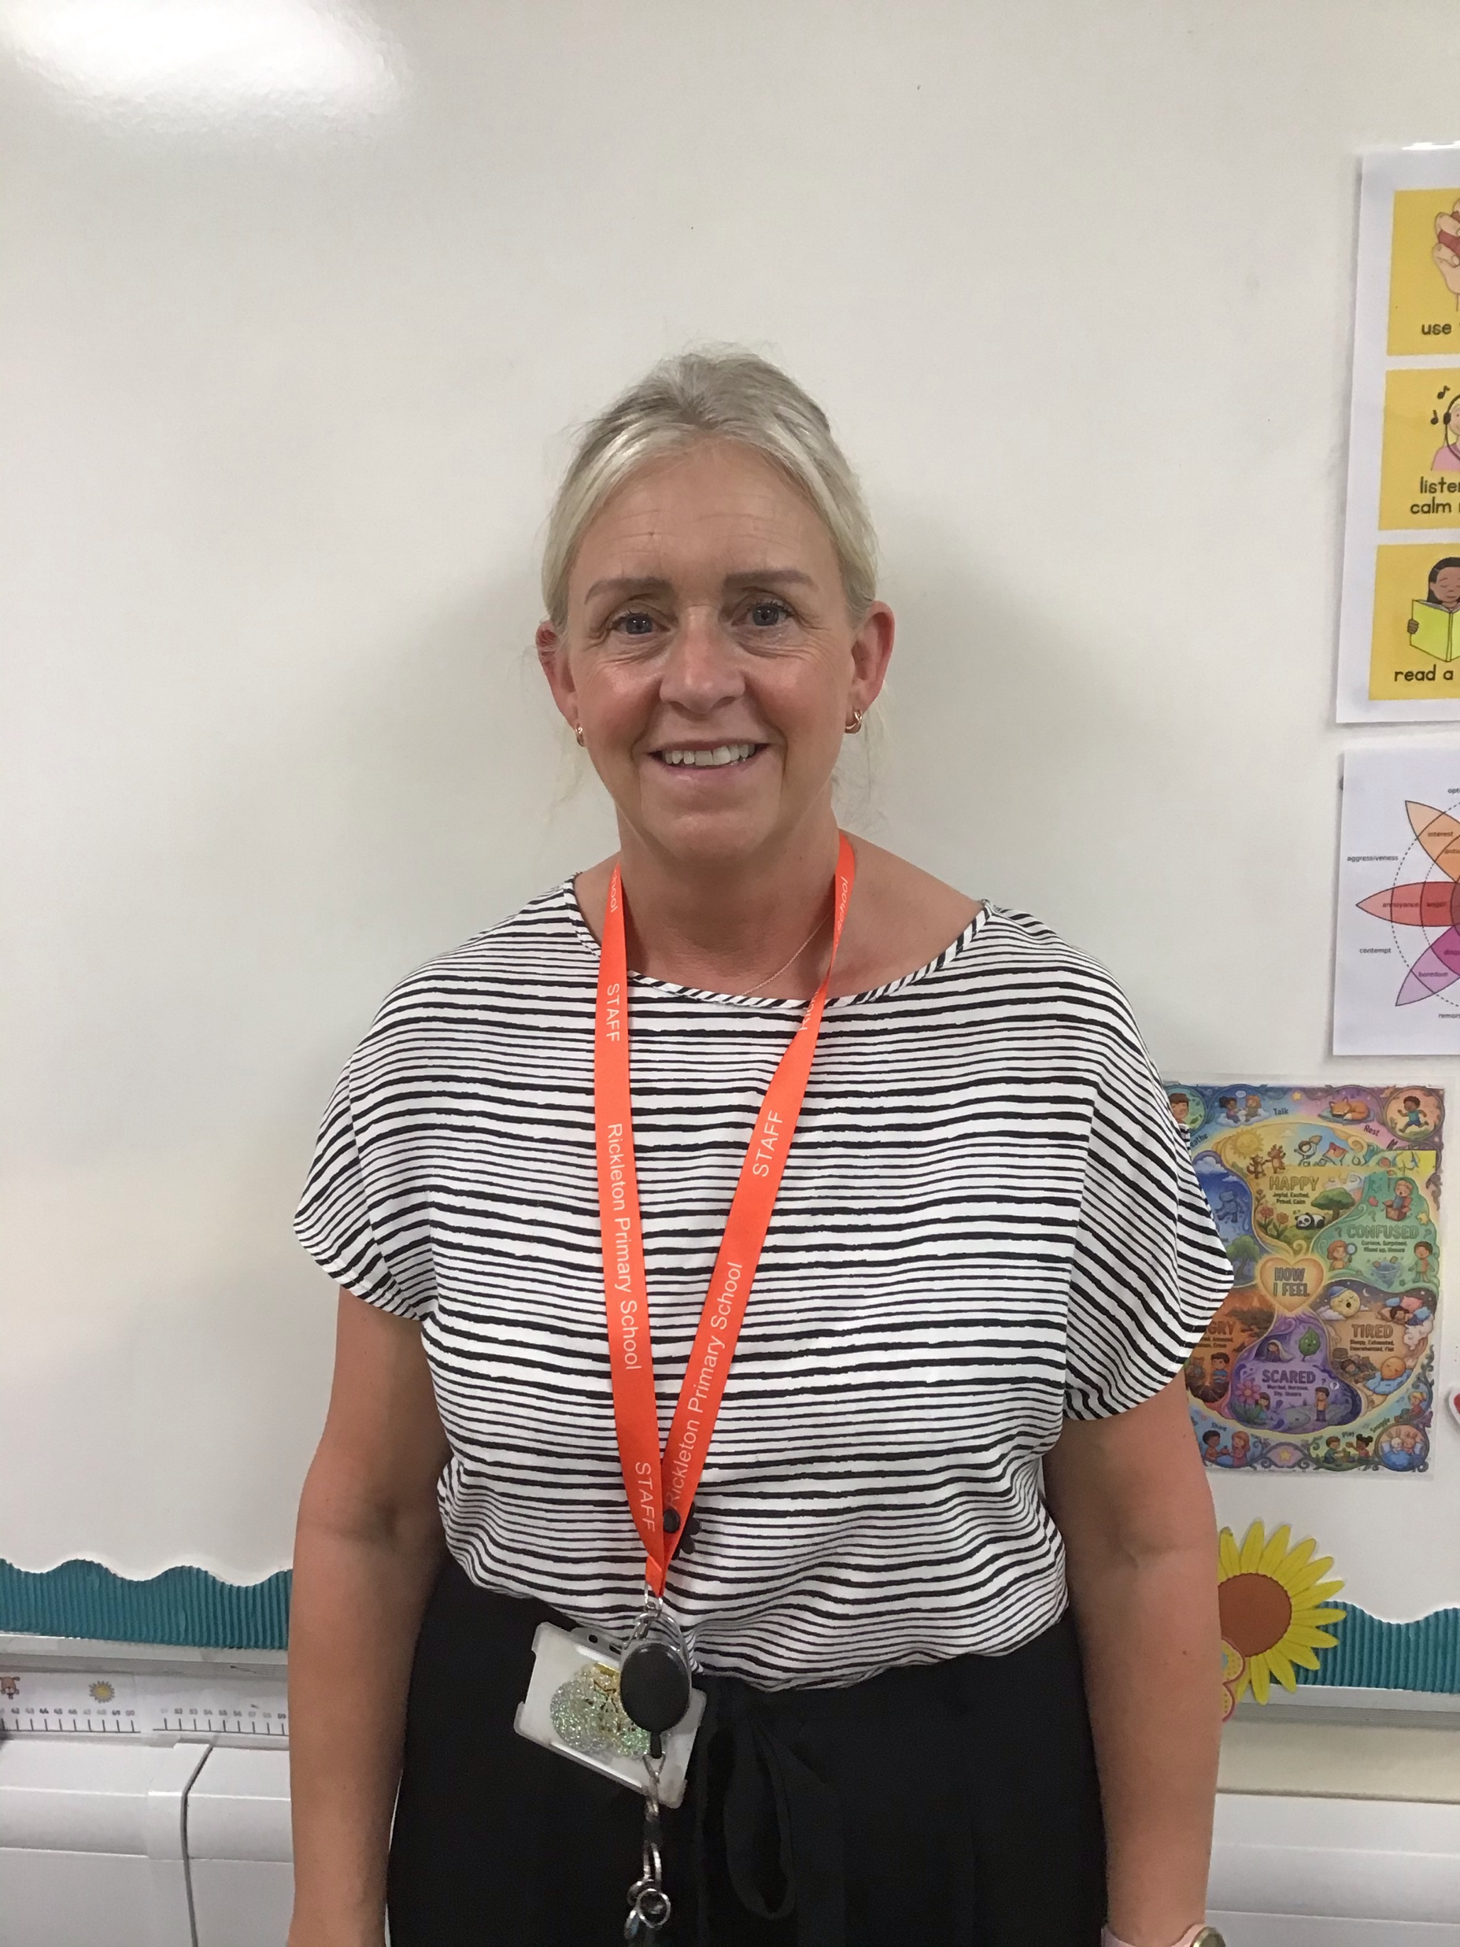
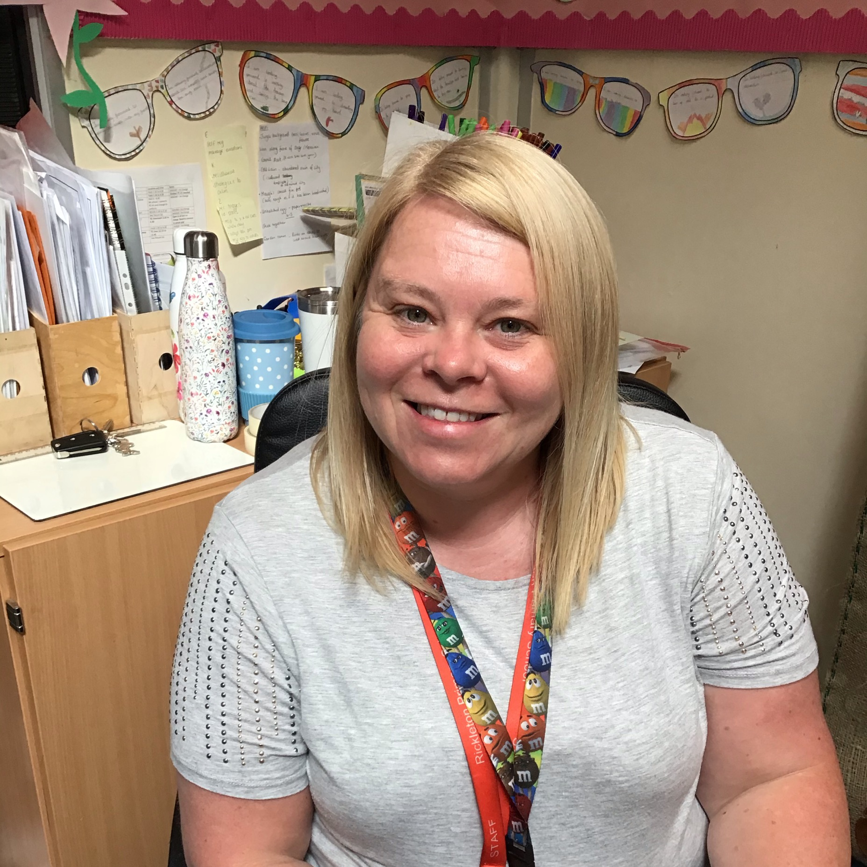
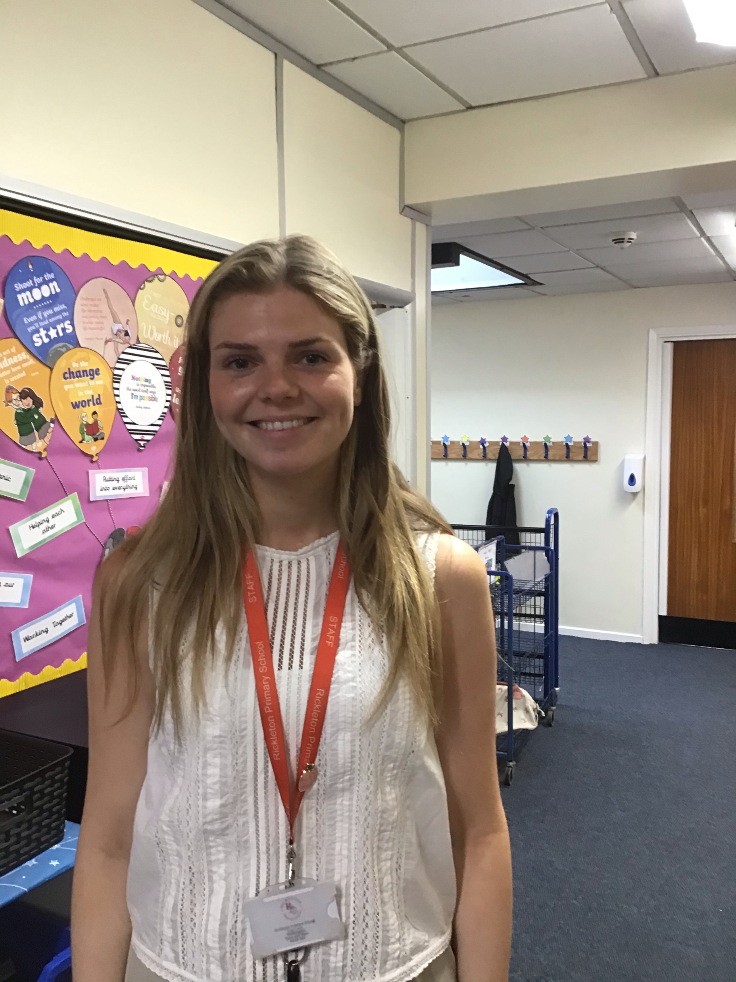
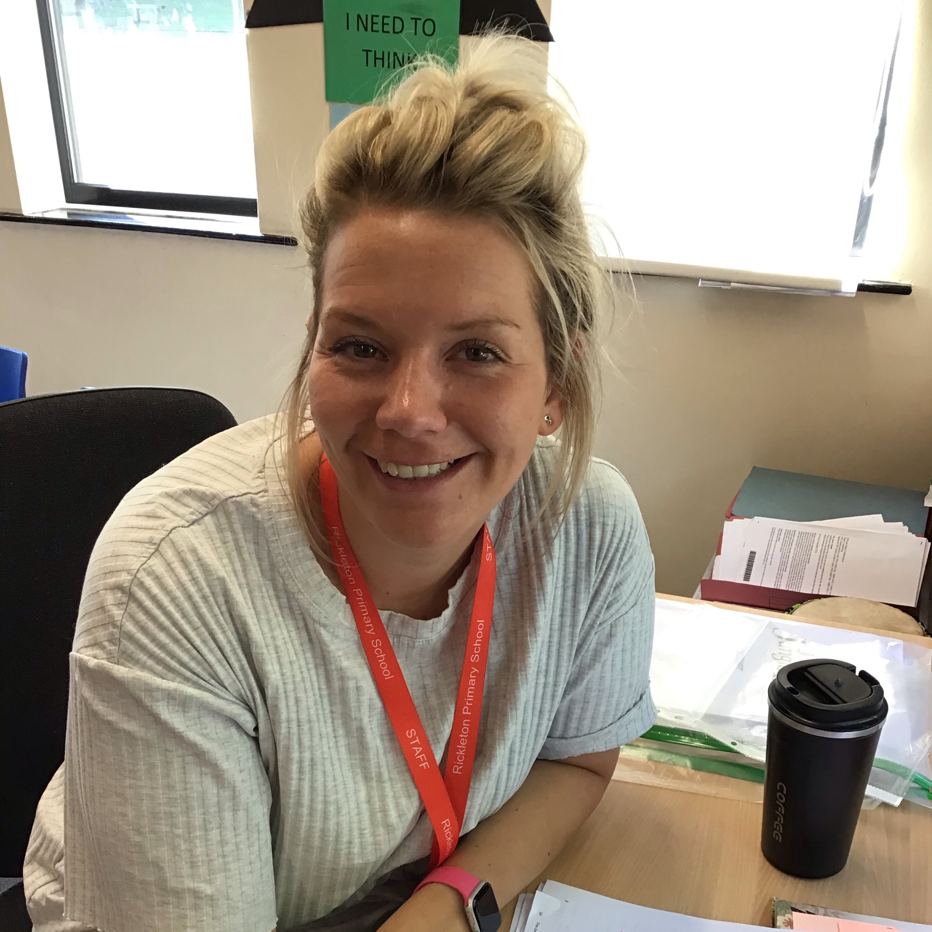
Our staff
Year Five teachers are Miss Robinson (Lilac) and Miss Oliver (Indigo). Mrs Bogan and Miss Young are the support staff for the year group.

Slide 3
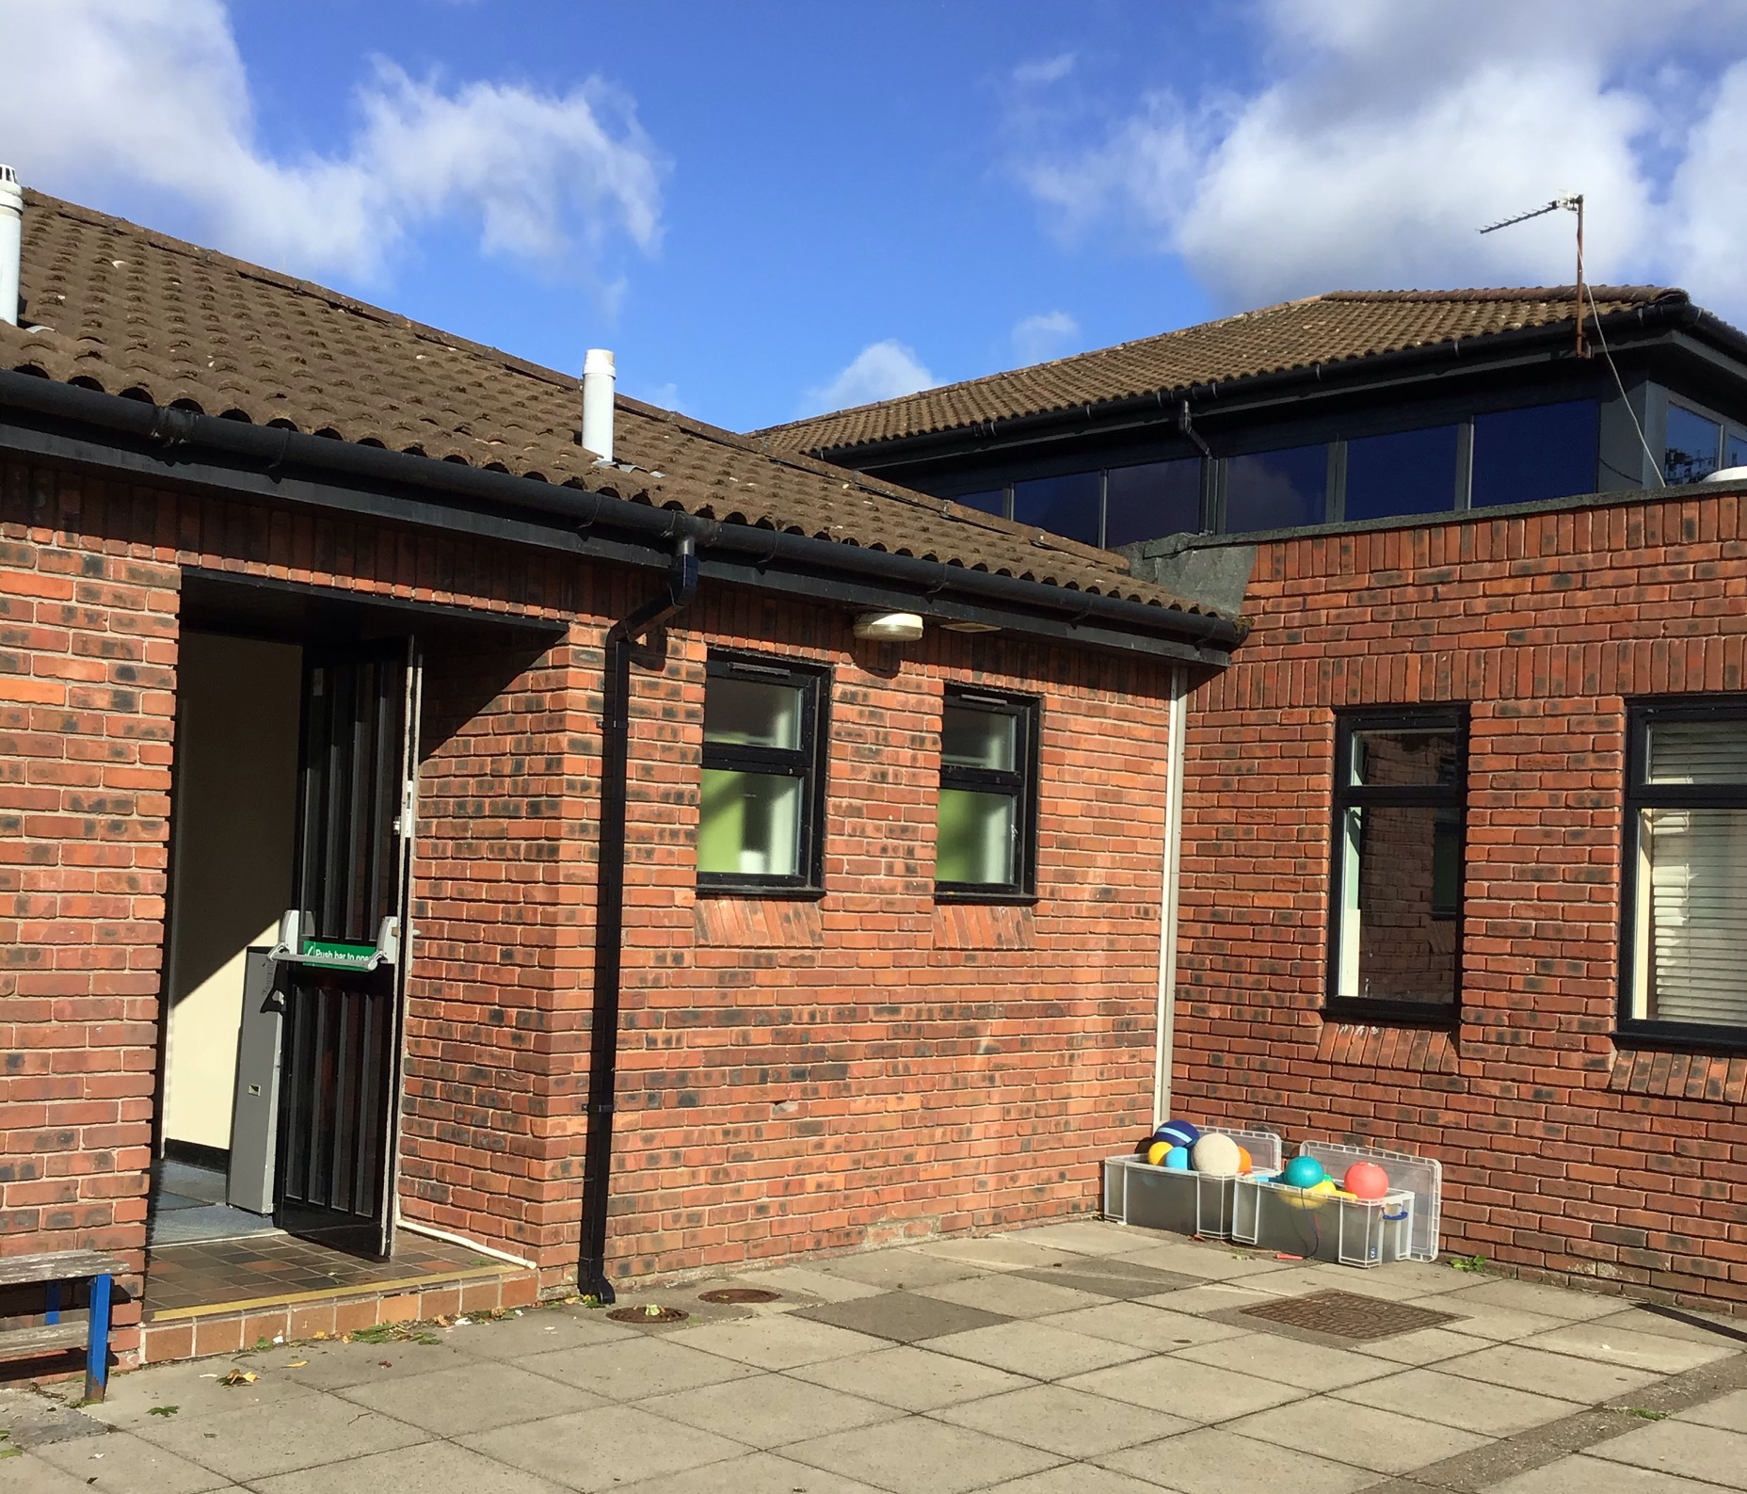
The School Day
Children will enter school via the Area 3 playground door. The doors will open at 8:45am and close at 8:55am.
Children will leave school at 3:30pm. All children will leave the building via the Area 3 playground door.
If children have permission from adults, they may walk home.
If children need mobile phones, they will need to be handed in to the class teacher once they are in school and will be stored in a secure place.

Slide 4

Our PE day is Friday.
The children will need to bring kits in each Friday containing trainers, Rickleton red t-shirt and shorts that are a suitable length. Earrings and watches will need to be removed before physical activity.
Mr O’Brien will be the PE teacher.

Slide 5
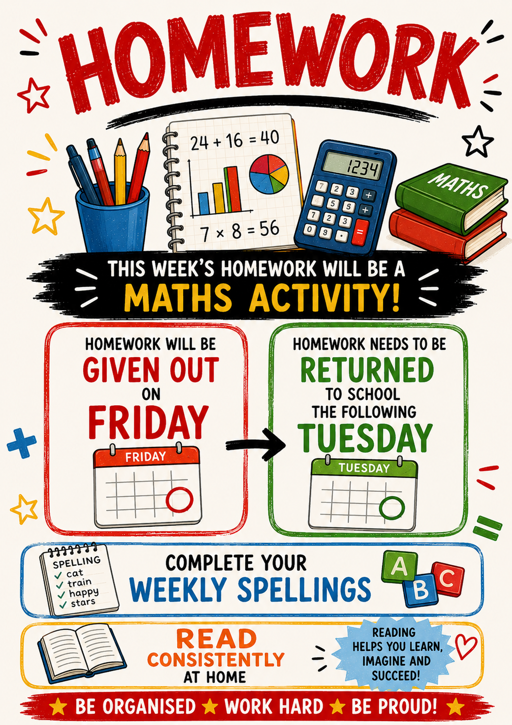
Homework will be given out every Friday and needs to be returned the following Tuesday. Homework will be a Maths activity, weekly spellings and daily reading.

Slide 6

Children need to bring in their reading book, reading record book, spelling logbook and a named water bottle to school every day. We would prefer them to use an RPS water bottle. For space in cloakrooms, we would prefer smaller rucksacks. Handbags are not suitable for school.

Slide 7
We look forward to seeing you in September!

