Slide 1

Welcome to Year Six

Slide 2
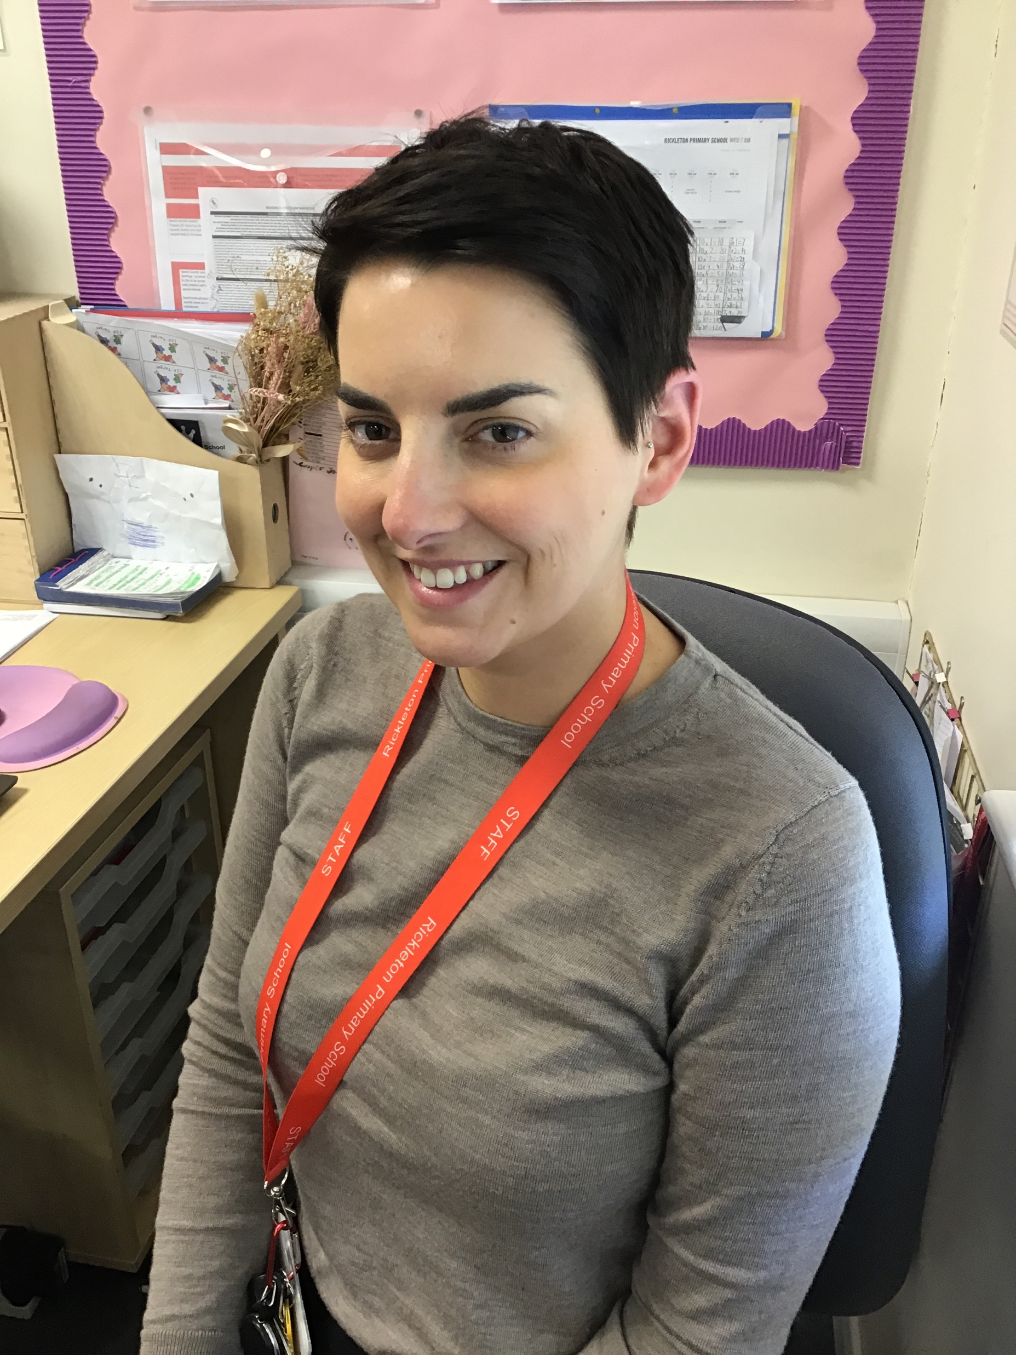
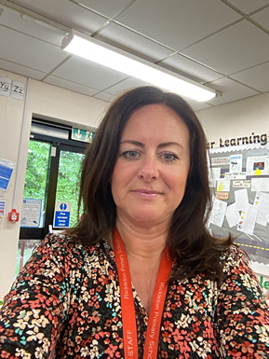
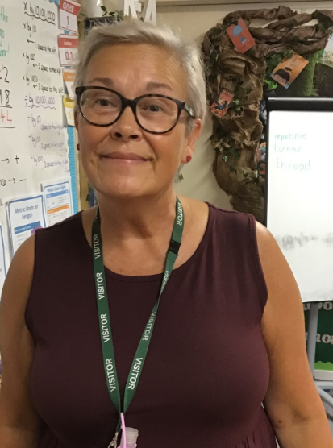
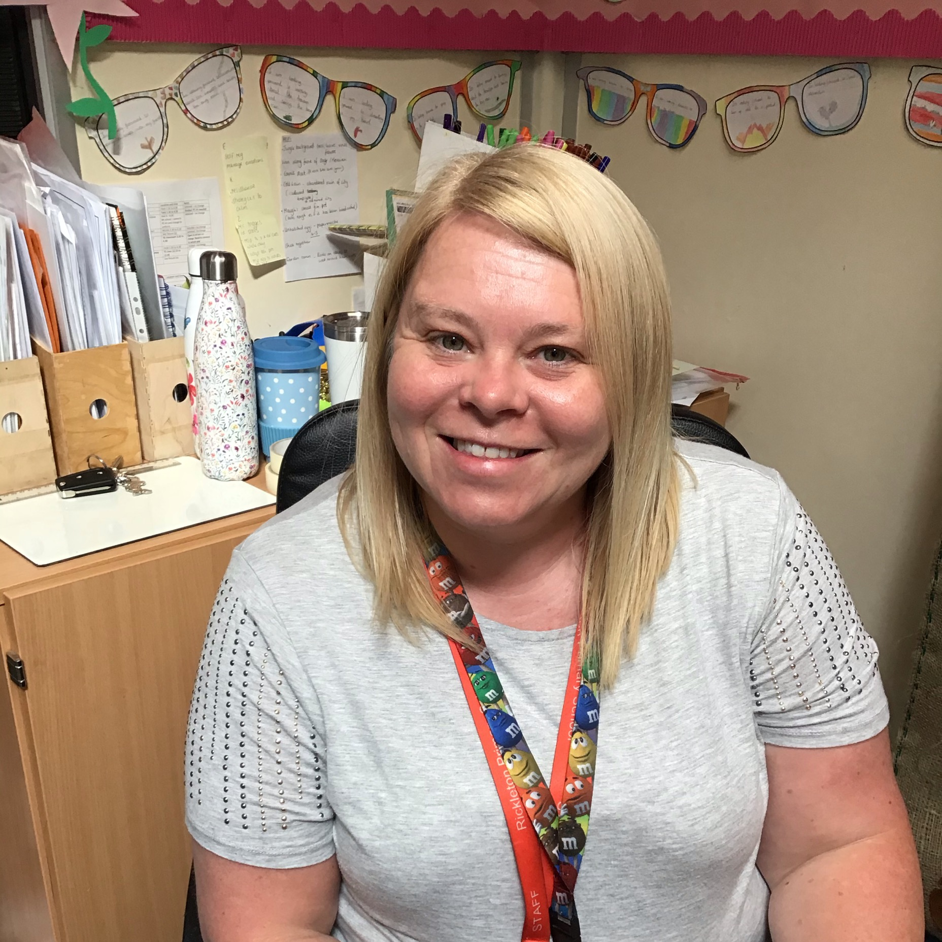
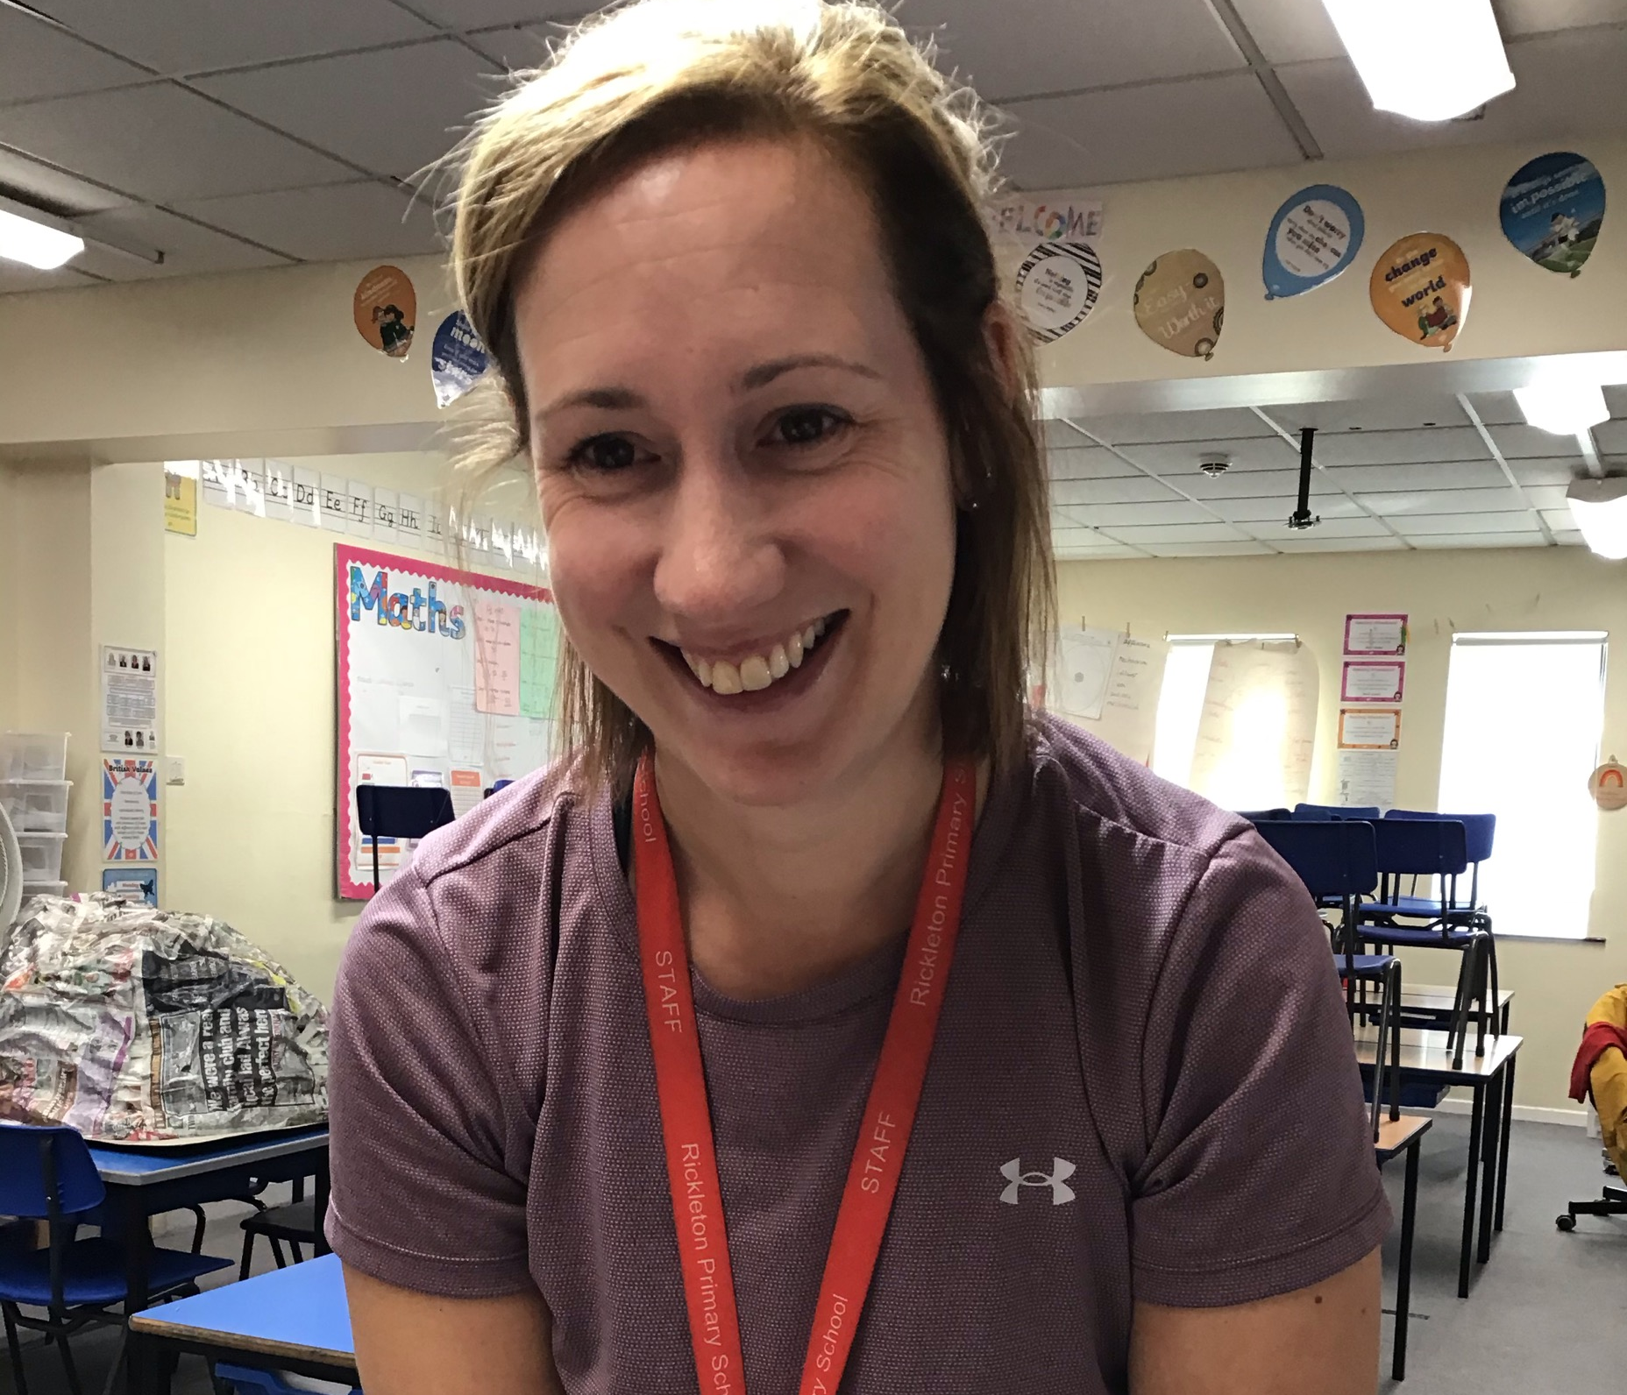
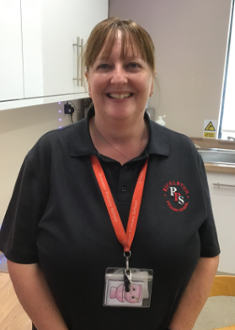
Miss Taylor is Magenta class teacher and Mrs Couling teaches Fuchsia class.
Mrs Bogan, Mrs Downey Mrs Robson and Mrs Burn are the support staff.

Slide 3
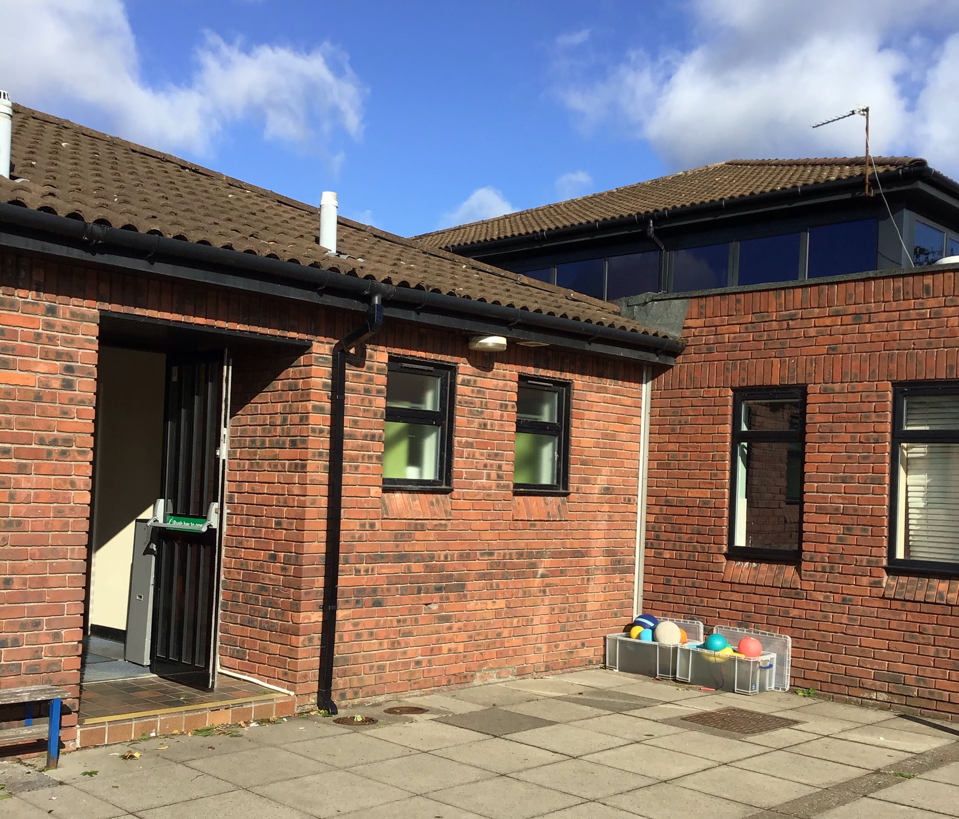
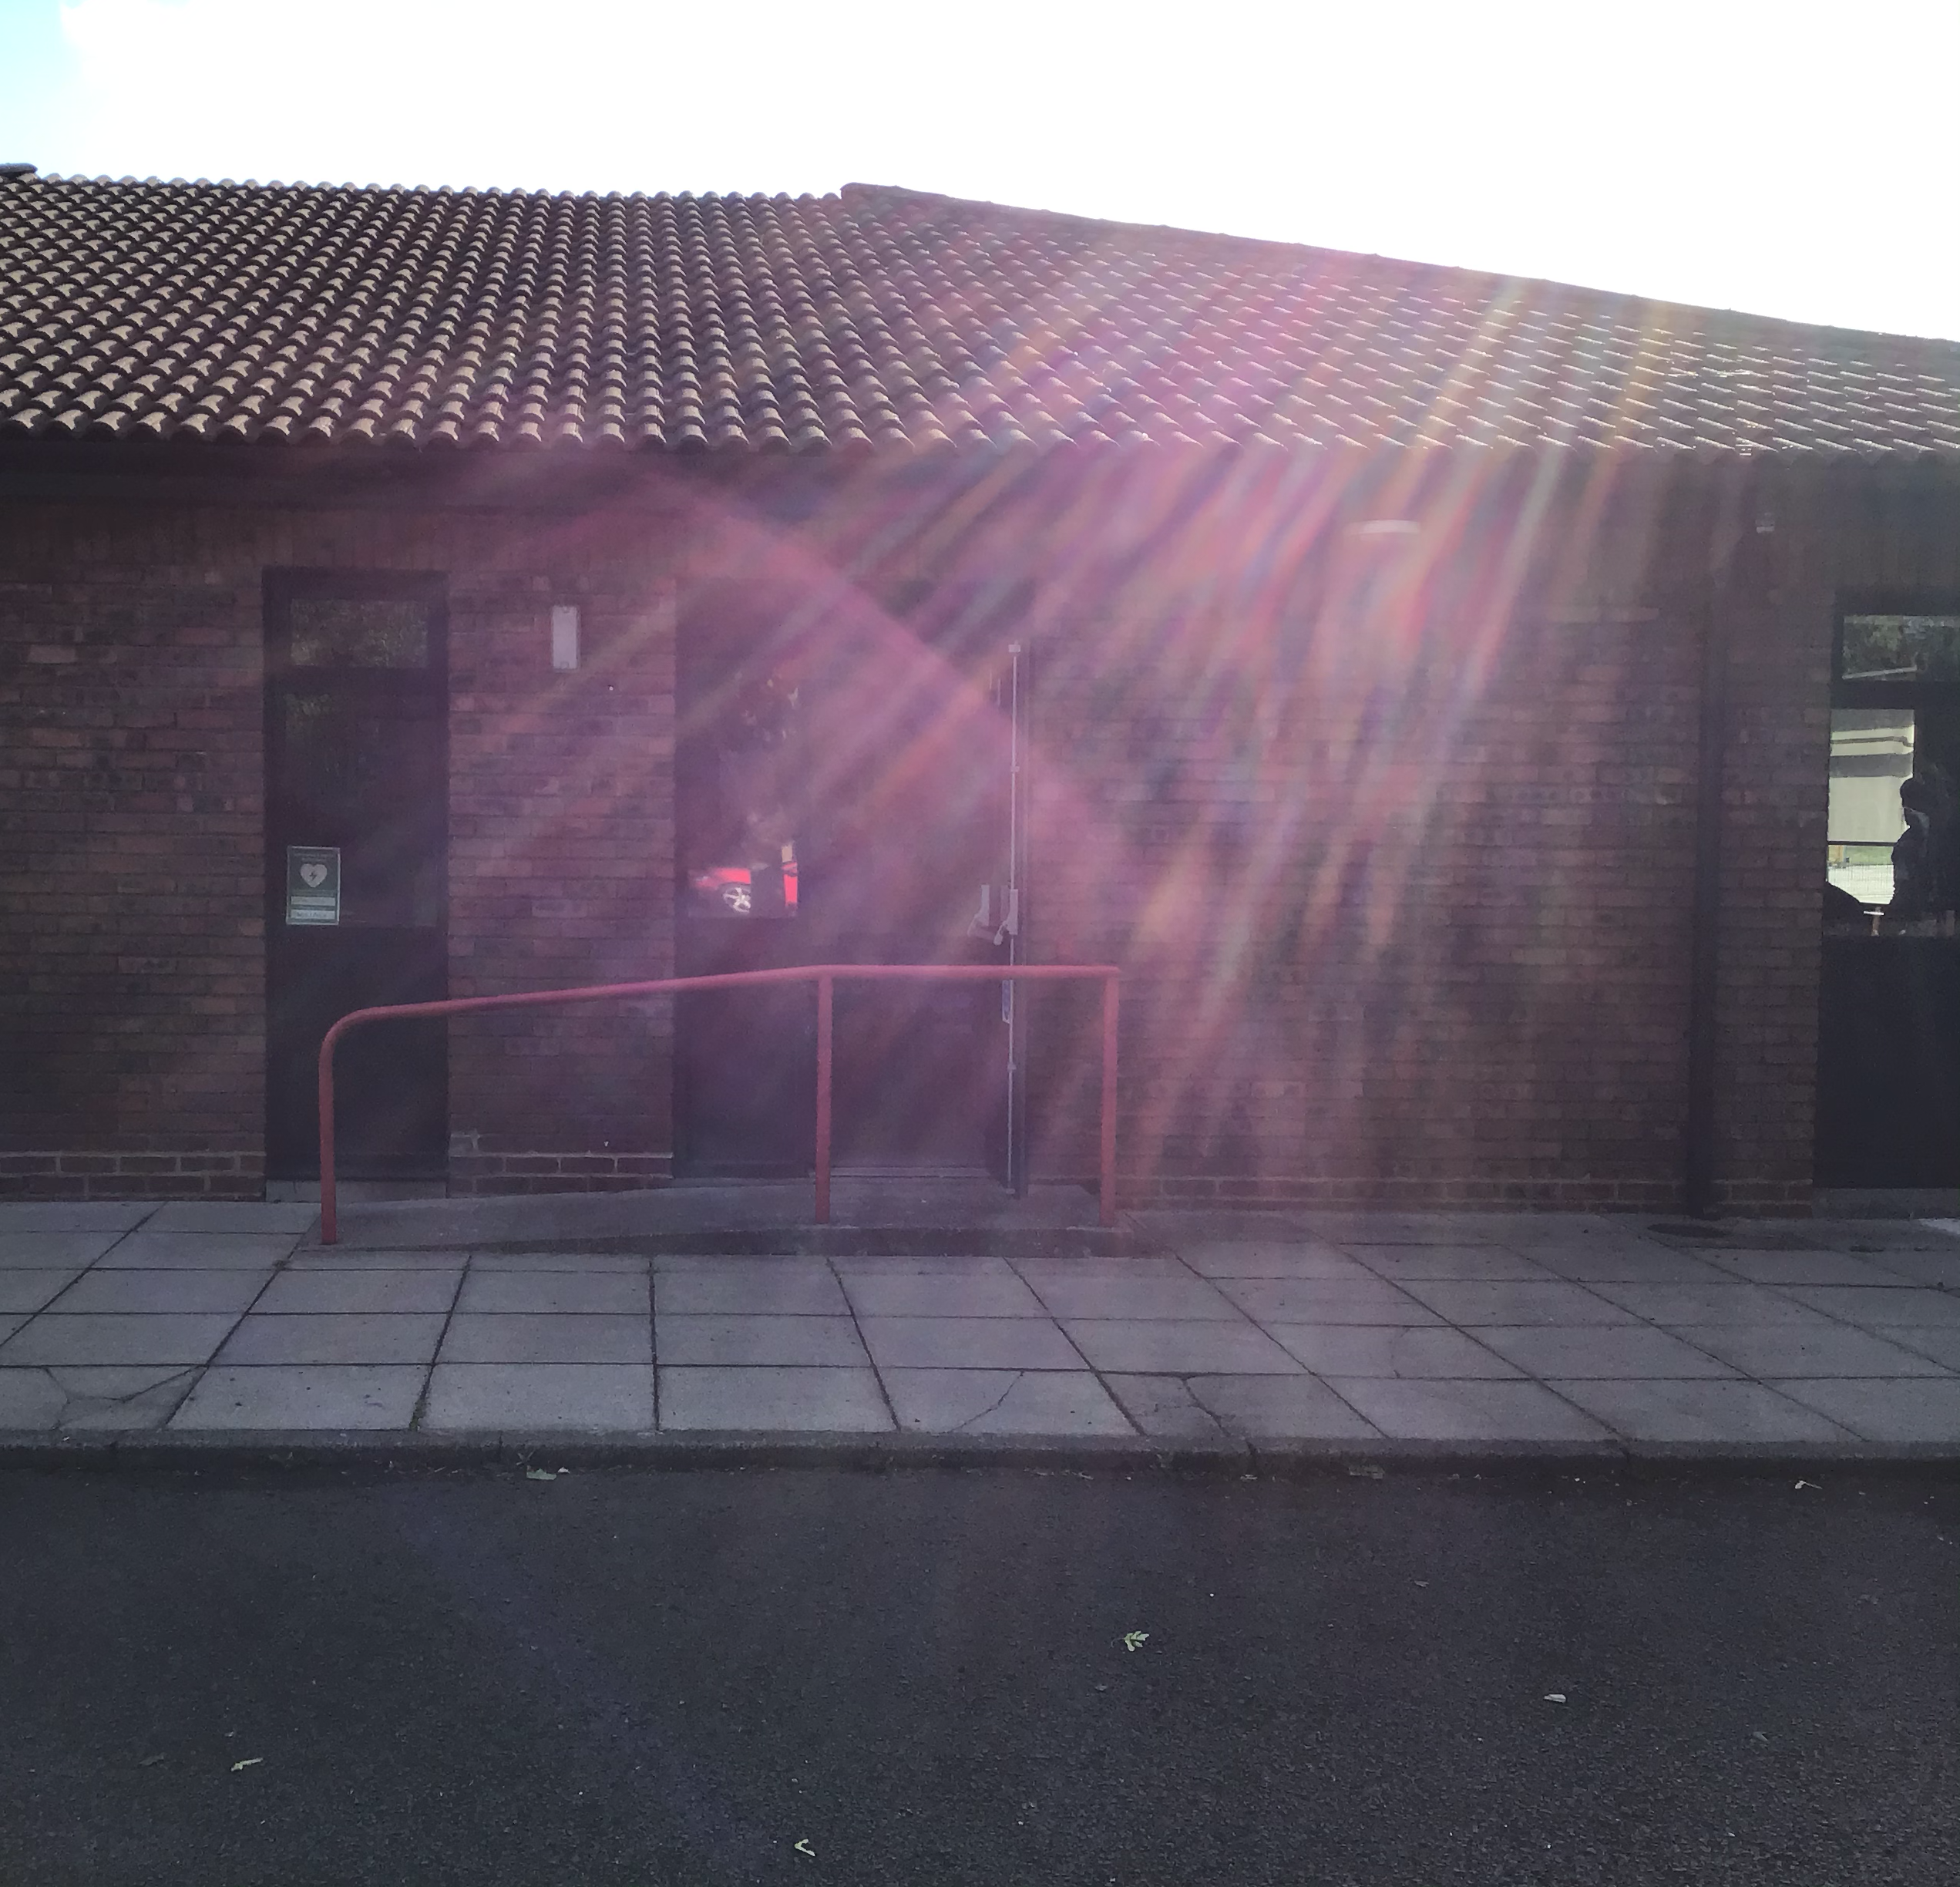
Children will enter school via the Area 3 playground door. The doors will open at 8:45am and close at 8:55am.
Children will leave school at 3:30pm. Children who do not have walking home permission will leave out of the Area 3 playground door. Children who have walking home permission will leave via Magenta fire door which is situated on the roundabout.

Slide 4

Our PE day is Monday. The children will need to bring kits in each Monday containing trainers, Rickleton red t-shirt and shorts that are a suitable length. Earrings and watches will need to be removed before physical activity. Mr O’Brian will be the PE teacher.

Slide 5
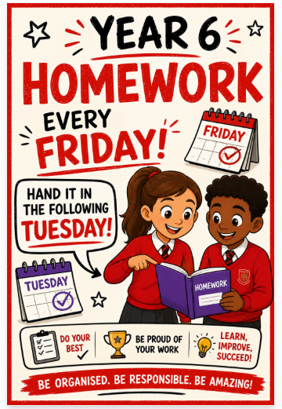
Homework will include a maths task, spellings and reading.

Slide 6

Children need to bring in their reading book, reading record book, spelling log book and a named water bottle to school every day. We would prefer them to use an RPS water bottle. For space in cloakrooms, we would prefer smaller rucksacks. Handbags are not suitable for school.

Slide 7
We look forward to seeing you in September!

