Slide 1


Welcome to Year 3

Slide 2


Staff in Year 3
Mrs O’Connor – Department Lead
Mrs Holt - teacher
Mr Woodhead - teacher
Mrs Hunter - support staff
Mrs Dawson – support staff
Miss Ramshaw – support staff
Mrs Carlson – support staff

Slide 3
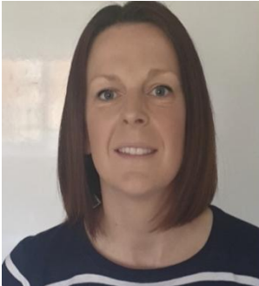
Mrs. O’Connor
Is excited to be working with some new year groups and learning about different topics.
She looks after Early reading skills and Attendance.

Slide 4
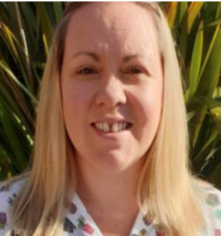
Mrs Holt
Looks after Year 3 in school and music.
She is looking forward to teaching the recorder
She enjoys musical theatre

Slide 5
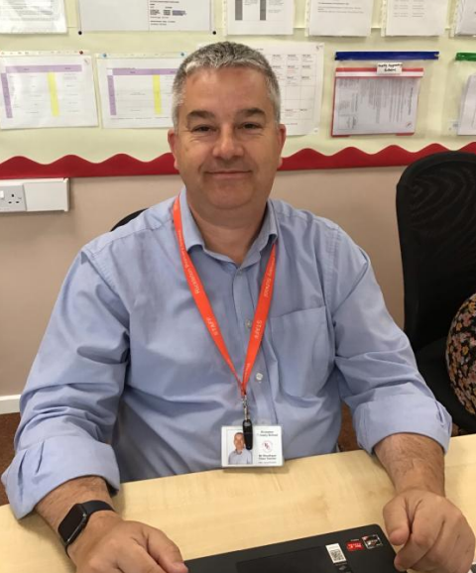
Mr Woodhead
Looks after Year 3 and P.E. in school.
He is looking forward to meeting lots of talented sports people.

Slide 6
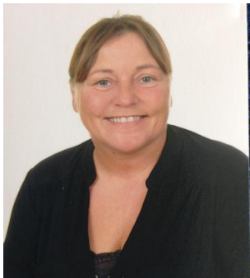
Mrs. Hunter
Mrs. Hunter is looking forward to moving up to Year 3 and working with her Rainbow club.

Slide 7
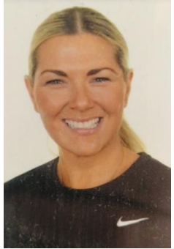
Miss Ramshaw
Miss Ramshaw loves to meet new children to work with.
She likes to dance and sing.

Slide 8
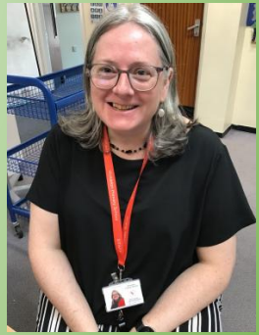
Mrs Carlson
Mrs Carlson loves the theatre.
She is excellent at speaking French.
She sometimes helps with Rainbow Club.

Slide 9

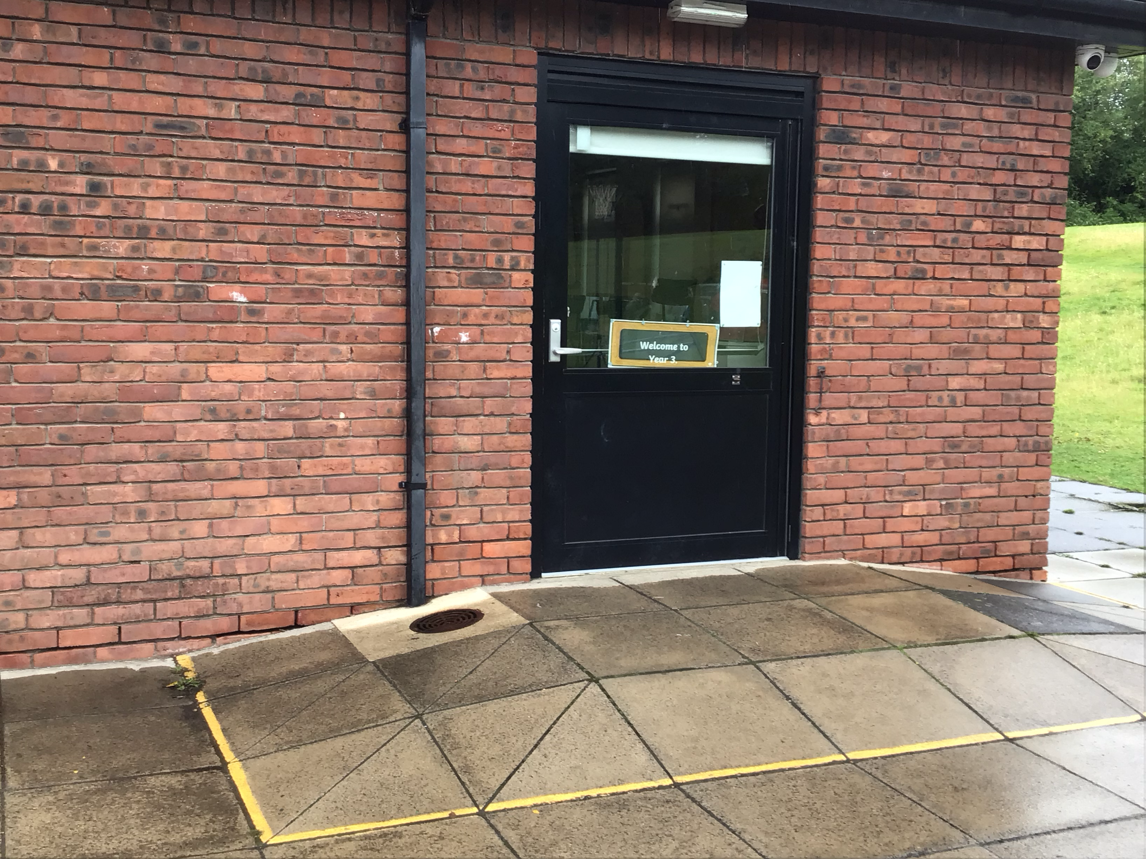
The School Day
We come into school between 8.45am and 8.55am.
All year 3 children enter through Mr. Woodhead’s door
We finish school at 3.30pm
Both classes leave through Mrs Woodhead’s door onto the playground.

Slide 10

P.E. Homework and daily equipment
P.E. for Year 3 is a Tuesday, please leave jewellery at home to keep it safe.
Homework is a maths task, daily reading and individual spellings in a spelling log.
Homework is given out on a Friday to be returned on the following Tuesday
Every day you will need a water bottle, red home-school contact book, reading book and spelling log.
Please remember that a snack for break should be a piece or fruit or peeled vegetable.

Slide 11
To be ready for Year 3 you could ….
Learn to tie your shoelaces.
Read some great stories
Learn to sharpen a pencil
Organise your own bag and equipment

Slide 12

Books you could read in Year 3 :

Slide 13


Slide 14
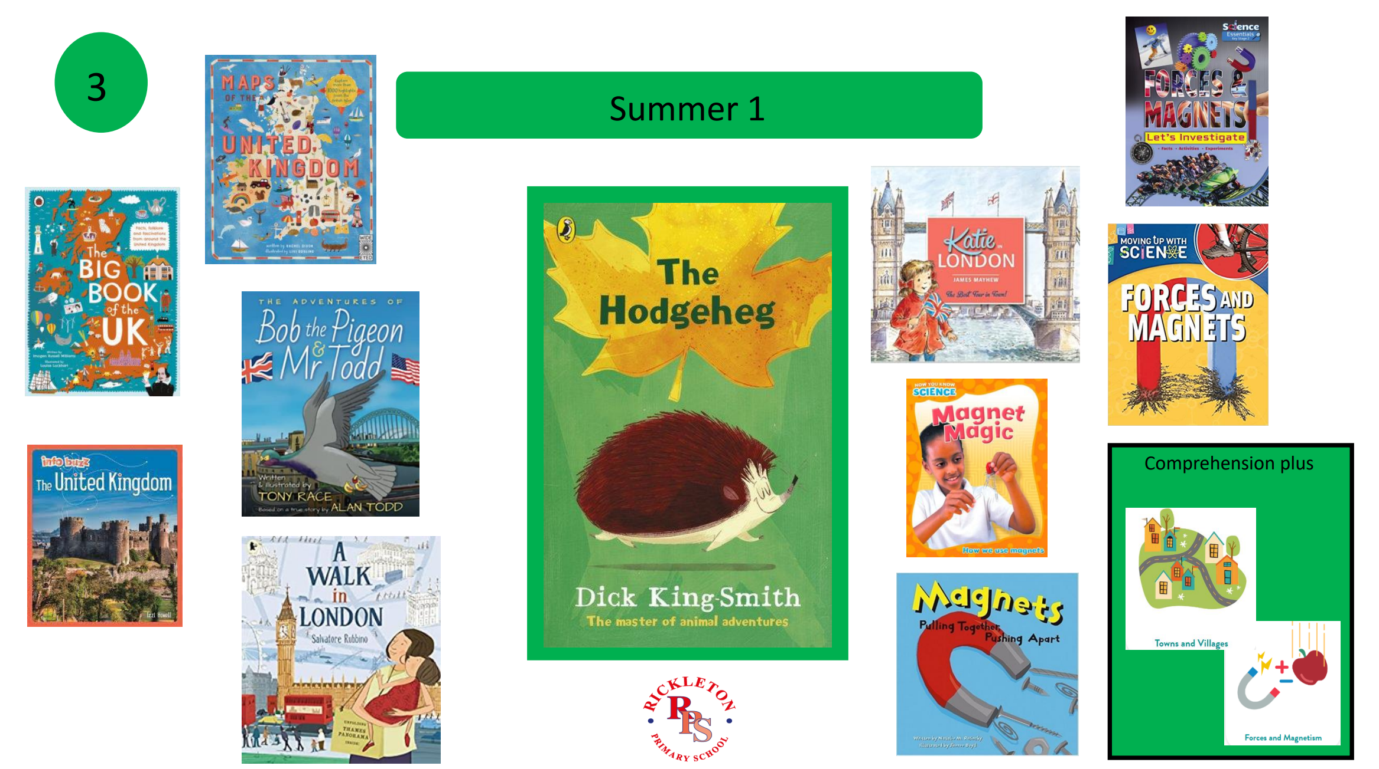

Slide 15

Have a great holiday!

