Slide 1

Welcome to Year Two

Slide 2
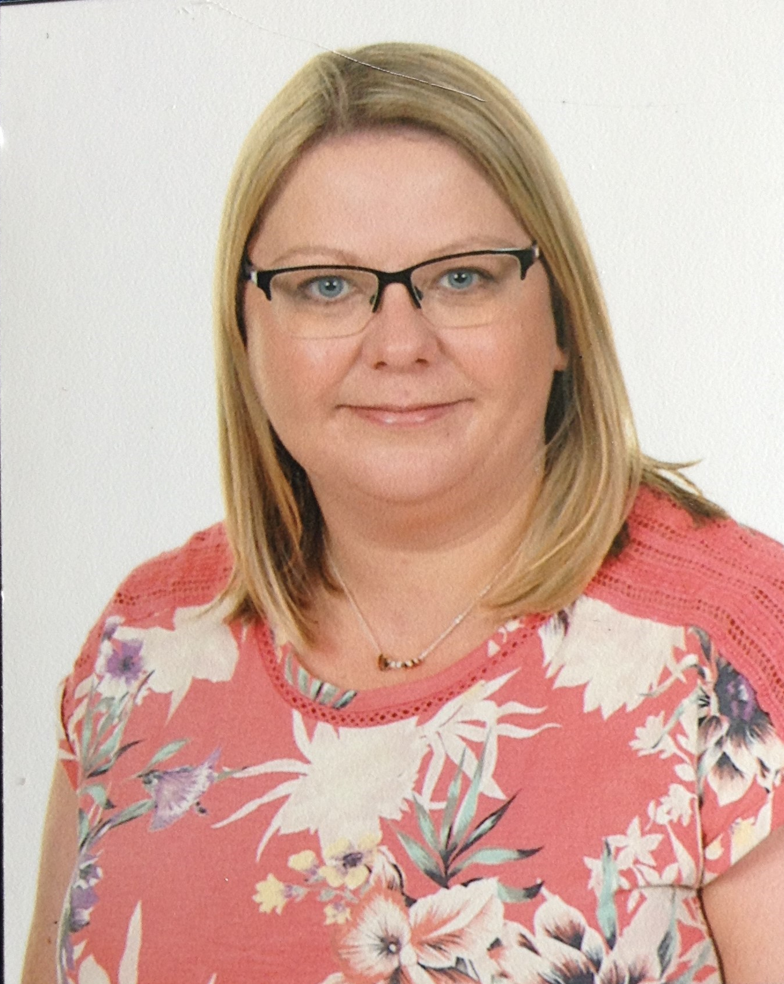
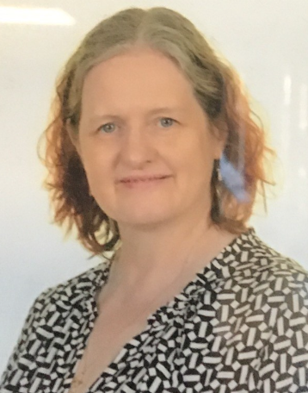
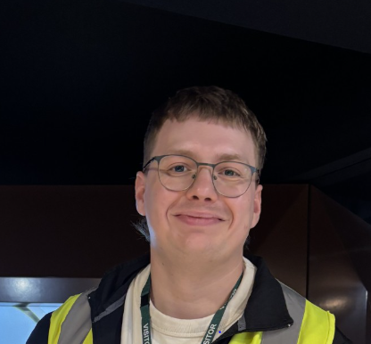
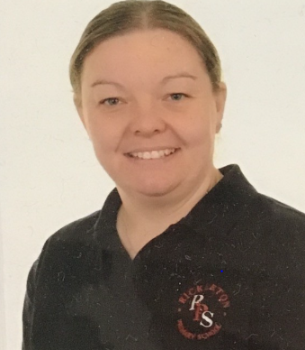
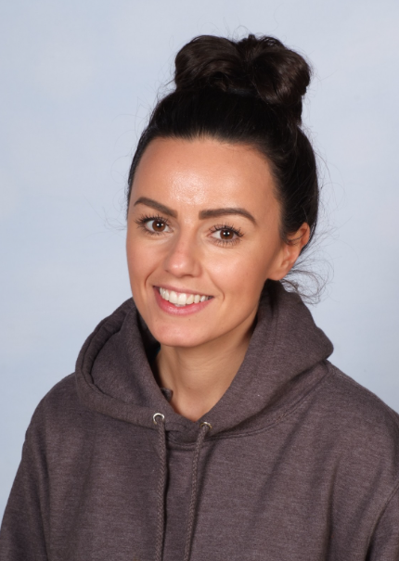
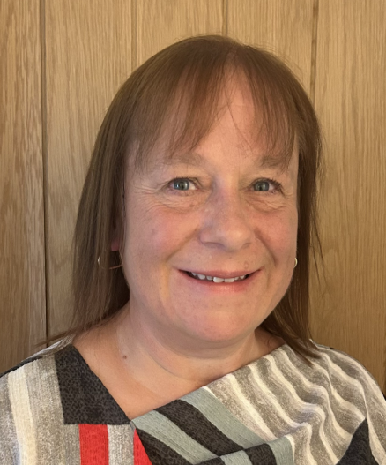
Our Staff
Mrs O’Connor
Mrs Banks
Mr Graham
Mrs Hallimond
Mrs Tulip
Mrs Hutchinson
Year Two teachers are Mrs K O’Connor/Mr Graham (Honey) and Mrs Banks(Saffron).
Mrs Hallimond, Mrs Hutchinson and Mrs Tulip are the support staff for the year group.

Slide 3
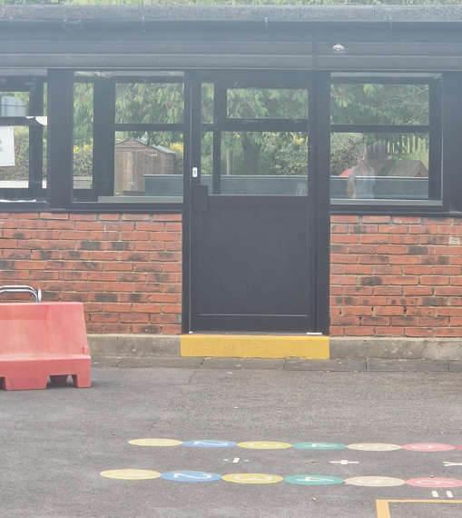
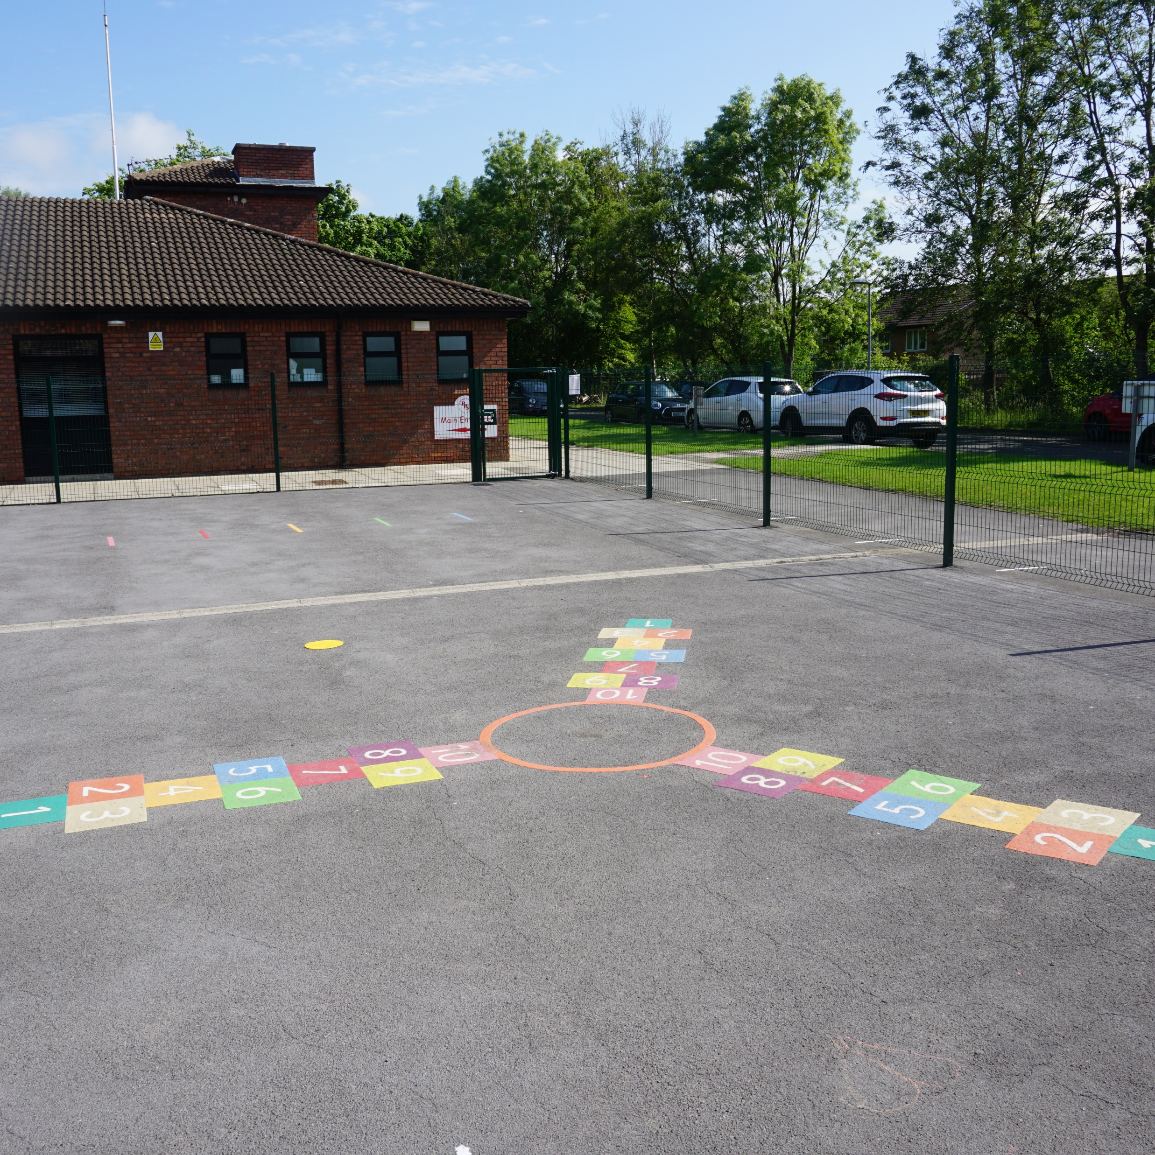
The School Day
Children will enter school via the playground door at the front of the school building. The doors will open at 8:45am and close at 8:55am.
Children will leave school at 3:20pm via the same door.

Slide 4

PE, homework and daily equipment
Year Two PE day is on Wednesday. Children will leave their P.E kits in school and it will be sent home at the end of every half term. Please ensure every item is clearly labelled. Children will need to remove earrings at home before any physical activity.
Children will need to bring their folder containing their home school contact book and reading books everyday. They will also need to bring their RPS water bottle to school each day.
Homework will be given every Friday and needs to be handed back in the following Tuesday.

Slide 5
We look forward to seeing you in September!

